Slide 1
How to get paid
This session is aimed at key stage three, four or five (recommended for Year 9 and above)

Slide 2
What is FLIC?
The Financial Times news group has set up a charity (Financial Literacy and Inclusion Campaign) focused on building up the financial knowledge and skills of everyone in the UK, especially the people that don’t usually come across this information.

Slide 3
Having a respectful learning environment
We will listen to each other respectfully
We will avoid making judgements or assumptions about others
We will comment on what has been said, not the person who has said it
We won’t put anyone on the spot and we have the right to pass
We will not share personal stories or ask personal questions

Slide 4
Learning Outcome: To learn about different forms of employment, about tax and other deductions that may be taken from earnings, as well as how to speak up at work.
By the end of the session, students will be able to:
Analyse the advantages and disadvantages of different ways to make money and important factors to consider when choosing a job.
Explain the main salary deductions, and calculate income tax.
State rights at work regarding fair treatment and pay, and identify where to turn for support when facing problems in the workplace.

Slide 5
Contents
Chapter 1 - Income
01 How do people make money?
02 Different models of work and their pros and cons
03 What work benefits are available
Chapter 3 - Speaking up at work
09 Equal pay for equal work
10 Asking for a pay rise
11 Resolving problems at work
Chapter 2 - Deductions
05 Where does tax money go?
06 What do we mean by tax on income?
07 Deductions on a pay slip
08 Calculating income tax using tax bands

Slide 6
Chapter 1:
Income

Slide 7
How do people make money?
If there is a question that you do not wish to ask aloud, you can write it on a post-it note which will be collected throughout the session and answered at the end

Slide 8
National minimum wage rates 2022
First job, already employed or recruiting a team?
What is the minimum a person should be getting paid per hour?
Apprentice / Under 18
£5.28
Aged 23+
£10.42
Aged 18-20
£7.49
Aged 21-22
£10.18
For a full guide to national minimum and living wage rates see: https://www.gov.uk/national-minimum-wage-rates

Slide 9
National minimum wage or real living wage?
NATIONAL MINIMUM WAGE
LIVING WAGE
What is the national minimum wage?
What is the living wage?
A minimum hourly rate of pay for all adult workers that is legally-enforced.
It is against the law for employers to pay workers less than this and it is currently set at £10.42 for those aged 23+.
A wage that employers can choose to pay based on the standard cost of living. It is higher than the minimum wage.
This wage is different in London (£11.95) to other parts of the UK (£10.90) because the cost of living is higher.
Why might employers decide to pay the real living wage, which is higher?
Notes:
Let’s start with pay basics in the UK.
Is anyone able to share with the group the difference between the national minimum wage and the living wage.
Does anyone know the difference in amount between the two? (the answers are animated to appear in slide show mode).
It is worth finding out whether your employer pays the Living Wage before you apply for a job.
Instruction
Share and read the definitions.
National Minimum Wage - the minimum pay per hour almost all workers are entitled to by law.
National Living Wage - higher than the minimum wage, workers get it if they’re over 23. It’s the highest band of the National Minimum Wage.
The Real Living Wage - a wage that employers can choose to pay (above the minimum wage). It is set by an independent charity to support people to achieve an adequate standard of living.

Slide 10
There are many ways to generate income
Using the examples below, can you think of somebody who makes money outside of their day job?
It could be a personal relation, a TV character or celebrity. Discuss how they get this money.
9am-5pm traditional job
Self-employment
Investment in stocks and shares, crypto or other assets
Side hustle / variable hours
Pensions
Rental income
Inheritance
Government benefits

Slide 11
There are many ways to generate income
Lots of stars make money in more ways than you may think
Marcus Rashford
Main job: Professional footballer for Manchester United and the England national team
Passions and additional income streams: Marcus is passionate about child food poverty and literacy in the UK. He writes books and has a very well paid sponsorship with Nike.
Jessica Alba
Main job: Actress
Passions and additional income streams: Jessica is a successful businesswoman and co-founded the healthy household goods start-up, The Honest Company in 2011.
She also invests in start-ups like Headspace.
Notes:
Jessica Alba
In addition to founding her household product company, Honest Co., back in 2011, Alba has also made investments in startups like Headspace and Managed by Q.
https://financebuzz.com/celebrity-investors
Marcus Rashford
He is a campaigner against racism, homelessness and child hunger in the United Kingdom. Rashford has been praised for using his platform to be a political activist and philanthropist to drive societal change. For his efforts, he has received widespread praise, and has been recognised for his efforts from organisations both in and outside of sport. He’s also written a childrens book “You Are a Champion: How to Be the Best You Can Be …” which he earns from to inspire children to reach their full potential

Slide 12
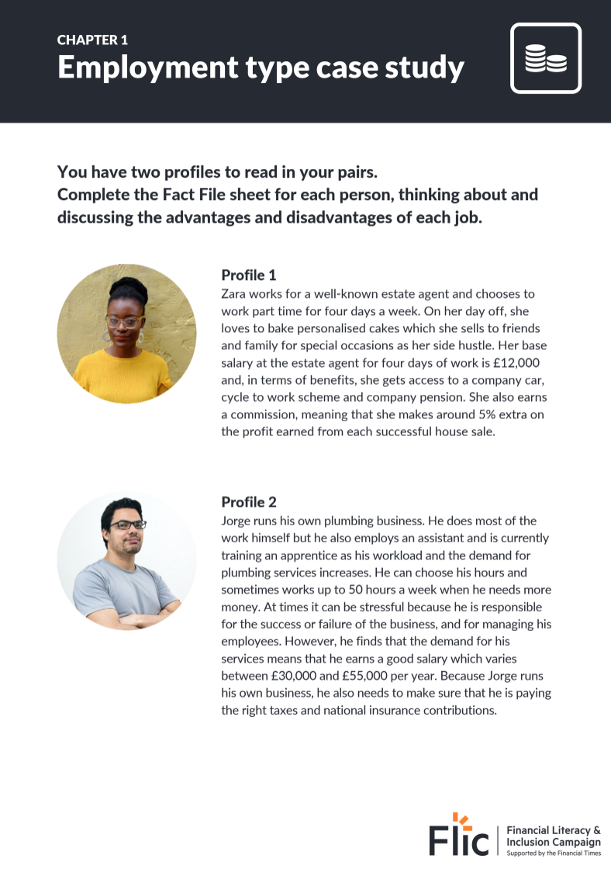
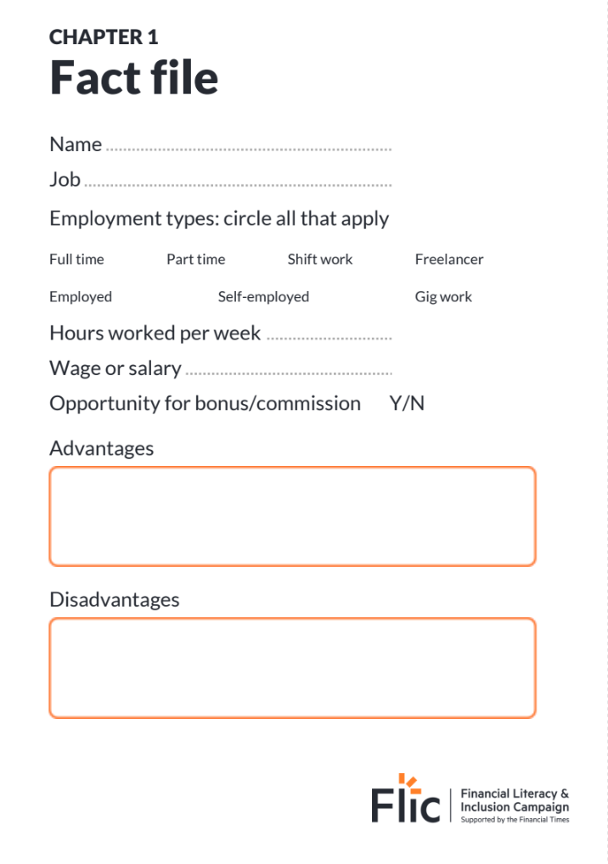
Different types of work
There are lots of ways people can earn money
Complete the Fact File for two job profiles
Your job profile should include;
Name of the Job
Employment types (you can circle multiple options): Full time | Part time | Shift work | Freelancer Employed | Self-employed | Gig work
Hours or days worked per week
Wage or salary
Opportunity for bonus/commission/tips
In your opinion the advantages and disadvantages of the job
Resource 1: Employment case study sheets | Optional - Resource 2: Fact file worksheet

Slide 13
What are the advantages and disadvantages of these jobs?
Zara
Job Title: Estate agent
Type of Employment: Employed,
Part-time
Weekly hours/days worked:
4 days
Wage or salary: £12,000
Bonus/commission/tips?: Yes, 5% commission on the profit of a home sold
Shivaughn
Job Title: Food delivery courier
Type of Employment: Zero-hours, Part time
Weekly hours/days worked: Depends, roughly 3 days
Wage or salary: £11 per hour on average
Bonus/commission/tips?: No
Jorge
Job Title: Plumber
Type of Employment: Self-employed, Full-time
Weekly hours/days worked: Varies but at times 50 hours a week
Wage or salary: £30,000-£55,000
Bonus/commission/tips?: No

Slide 14
What are the advantages and disadvantages of these jobs?
Advantages
Part-time allows someone to take care of other responsibilities like study or childcare
Commission can be seen as a reward for good work
Disadvantages
The salary is below the national average
Advantages
Salary can be quite high
Being self-employed means you can decide the rules and standards for your business
Disadvantages
Long hours
Being self-employed means you might not be able to afford to hire people for admin jobs
Advantages
The wage is above national minimum wage for a job in this field
Good for occasional, fast money
Disadvantages
Zero-hour contracts mean work is not guaranteed and workers are not paid for holidays or sickness

Slide 15
What are the advantages and disadvantages of these jobs?
Advantages
He earns a high salary of £47,000
He can earn a bonus
He works with motivated people
Disadvantages
He works long hours so has less time for other things that he enjoys
His work can become stressful
Advantages
The wage is above national minimum wage for a job in this field
It’s a sociable job which she enjoys
She gets a 30% discount on the cafe’s food so can save money that way
Disadvantages
She sometimes has to deal with difficult customers
Her work shifts are sometimes unsociable
Advantages
His job meets his passions for creativity and business
He can work abroad from Greece
He loves the variety of work which he can do as a freelancer
Disadvantages
His pay is unstable - sometimes he has lots of projects coming in; other times not
He has to be organised
What kind of job do you think you would like and why?

Slide 16
Workplace benefits
In addition to the type of job, the salary and the working hours, an employer might also offer workplace benefits that make the job more attractive.
Can you think of any others?
Child
care vouchers
Free stuff or food
Cycle to
work scheme
Company
discount
Company
car
Health
insurance

Slide 17
Personal reflection
What kind of job do you think you would like and why?
What is your dream job?
Write a short paragraph about the model of work that would suit you in your twenties. You should include:
Employment types (you may choose multiple of these): Full time | Part time | Shift work | Freelancer | Employed | Self-employed | Gig work
Hours or days worked per week
Wage or salary
Explain reasons for your choice.
Stretch: Describe the disadvantages of your choice and how you might overcome them

Slide 18
Any questions?
?

Slide 19
Learning Outcome: To learn about different forms of employment, about tax and other deductions that may be taken from earnings, as well as how to speak up at work.
By the end of the session, students will be able to:
Analyse the advantages and disadvantages of different ways to make money and important factors to consider when choosing a job.
Explain the main salary deductions, and calculate income tax.
State rights at work regarding fair treatment and pay, and identify where to turn for support when facing problems in the workplace.
Notes:
60 minutes

Slide 20
Chapter 2:
Deductions

Slide 21
Starter - Income recall activity
What type of work will suit this person?
Lucy is 27 years old and has a two year old daughter.
She lives in London and shares a flat with her sister.
Lucy has a degree in art and design.
Factors to consider:
How does being a parent impact the type of work that Lucy might choose?
How does living in London affect the wage that Lucy needs?
Does having a degree influence the type of job that Lucy will consider?

Slide 22
Learning Outcome: To learn about different forms of employment, about tax and other deductions that may be taken from earnings, as well as how to speak up at work.
By the end of the session, students will be able to:
Analyse the advantages and disadvantages of different ways to make money and important factors to consider when choosing a job.
Explain the main salary deductions, and calculate income tax.
State rights at work regarding fair treatment and pay, and identify where to turn for support when facing problems in the workplace.

Slide 23
Can you guess…
When was income tax first introduced?
Income tax was first introduced in 1799 to raise money to fight Napoleon in the French Revolutionary war.
What is tax spent on today?

Slide 24
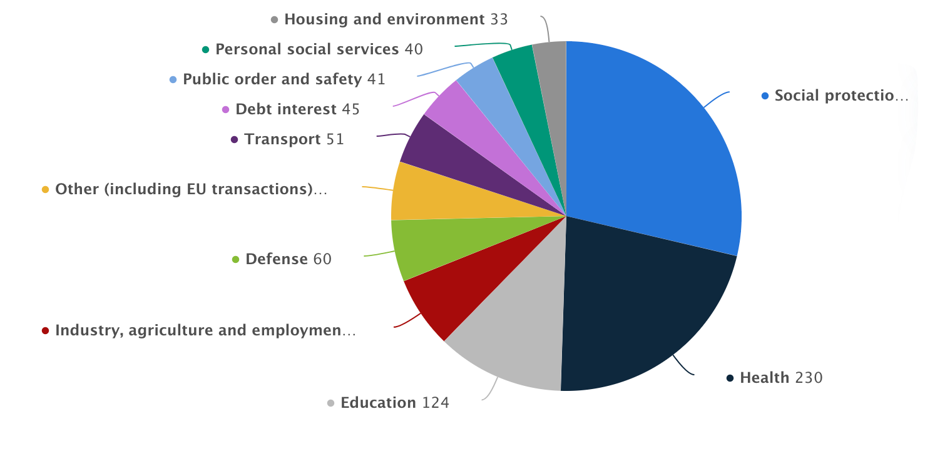
What is tax money spent on?
Match the main areas of public spending (listed in the box) to the segments on the pie chart
Health
Industry, agriculture and employment
Social protection (hospitals, home care)
Defence
Education
Transport
e
a
b
c
f
d
Challenge: Can you guess how much is spent on each area?
Notes:
Source: https://www.statista.com/statistics/298524/government-spending-in-the-uk/#:~:text=In%202021%2C%20the%20expenditure%20of,pensions%20and%20other%20welfare%20benefits.

Slide 25
What is tax money spent on?
(F) Health
(C) Industry, agriculture and employment
(E) Social protection (hospitals, home care)
(B) Defence
(D) Education
(A) Transport
Open up the Statista link here to see the full amounts in billions!
Notes:
Source:
https://www.statista.com/statistics/298524/government-spending-in-the-uk/#:~:text=In%202021%2C%20the%20expenditure%20of,pensions%20and%20other%20welfare%20benefits.

Slide 26
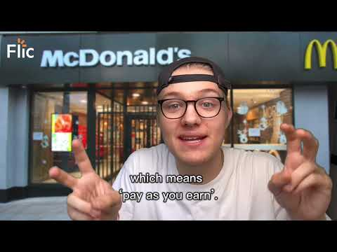
Taxes and the world of work
Watch here: https://www.youtube.com/watch?v=P26wizs8I20

Slide 27
Take home pay
Zara has been promoted and her salary has increased from £27,000 per year to £30,000.
How much will Zara get paid each month?
Congratulations Zara, you’ve been promoted
Job Title: Senior Estate agent
Type of Employment: Employed,
Full-time
Weekly hours/days worked:
5 days| 09:00 to 17:00
Wage or salary: £30,000
Bonus/commission/tips?: Yes, 5% commission on the profit of a home sold
Watch this video

Slide 28
Understanding taxes
For people in employment, there will be some deductions which are taken away from their gross pay.
These are the main ones, and we’ll focus on National Insurance and Income tax:
National Insurance
Income
tax
Student loan
Pensions

Slide 29
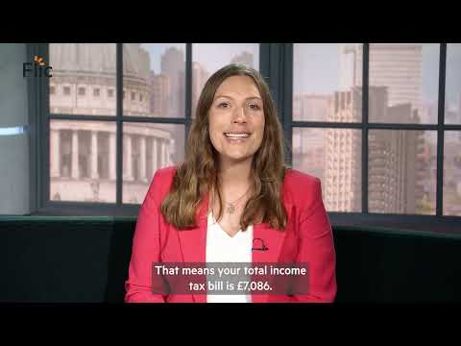
How does tax on my earnings really work?

Slide 30
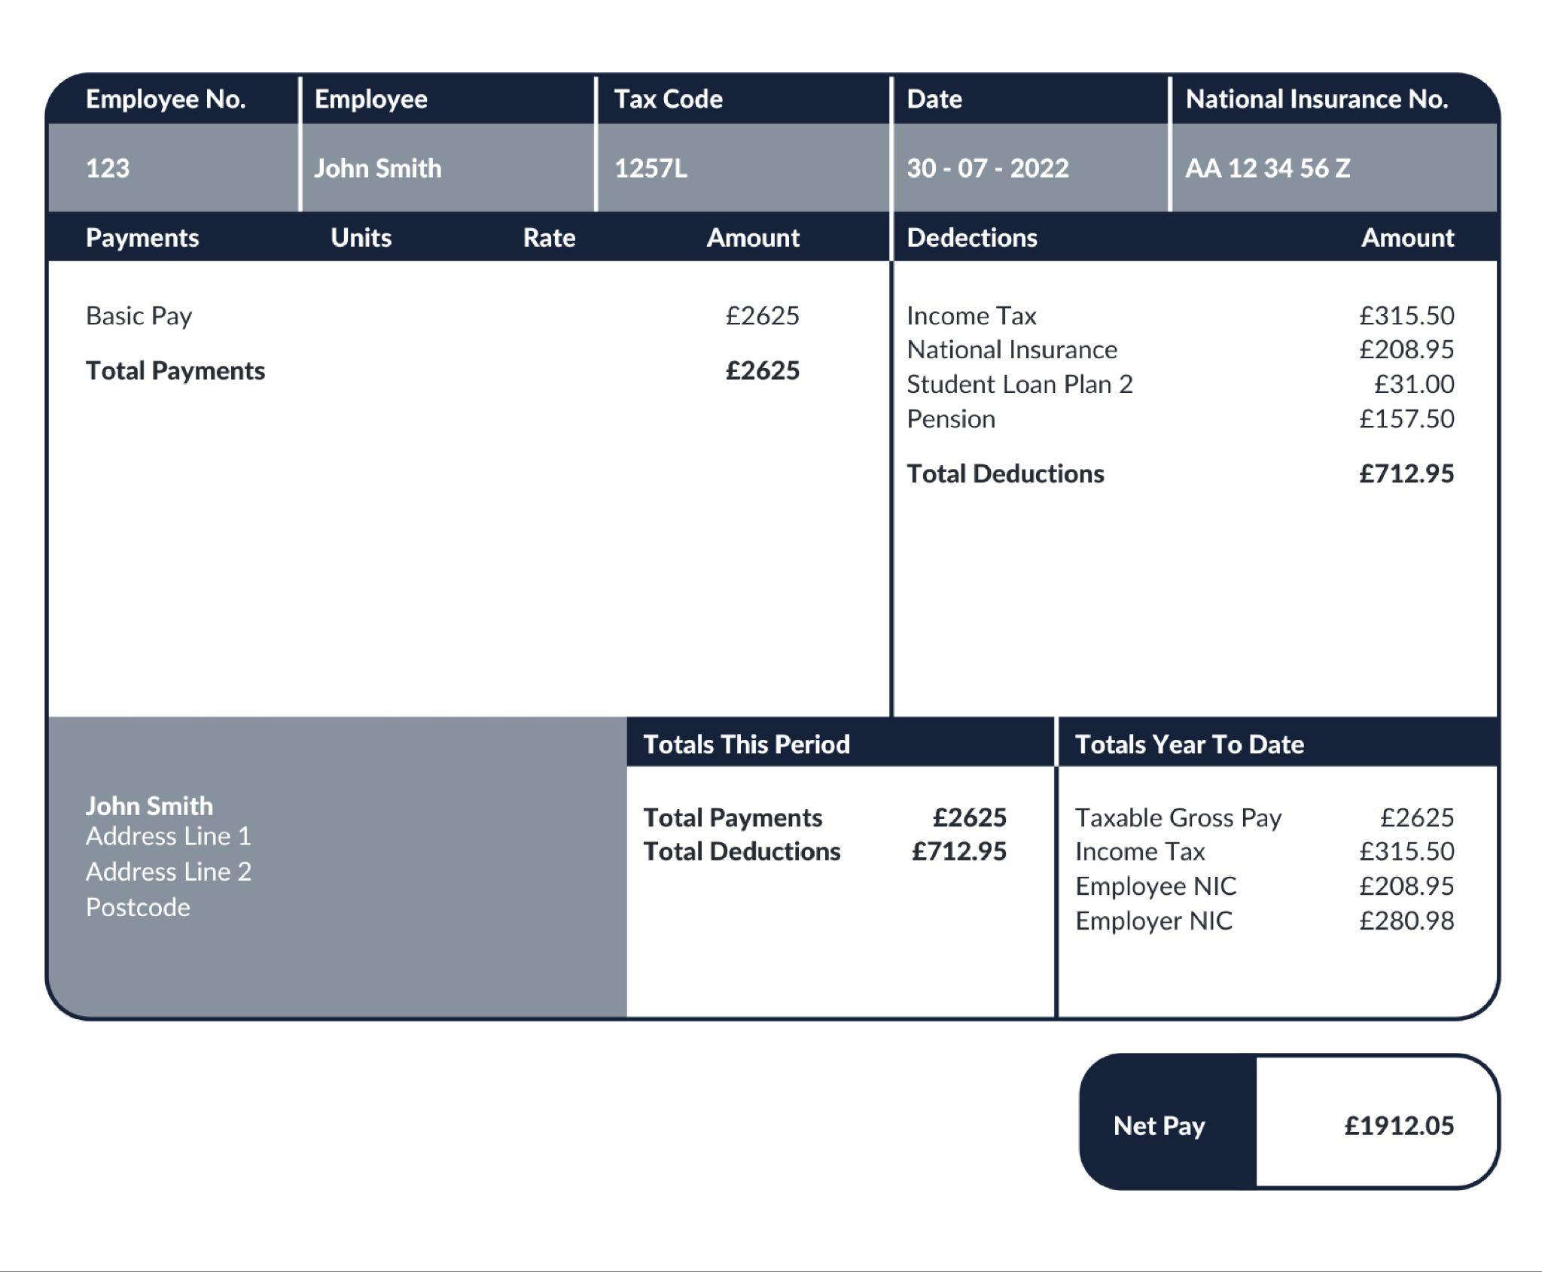
Understanding a payslip
What is this payslip
showing you?
Stretch: Can you write an equation to show how net pay is calculated?
Challenge: What advice would you give to someone who is looking for a new job and motivated by increasing their salary?

Slide 31
Understanding a payslip
Today we’re going to learn about DEDUCTIONS.
You will have to pay INCOME TAX and NATIONAL INSURANCE.
You’re likely to have a PENSION and may have to pay back a STUDENT LOAN.
Notes:
You will also have to pay a pension - more on that in wider FLIC modules.

Slide 32
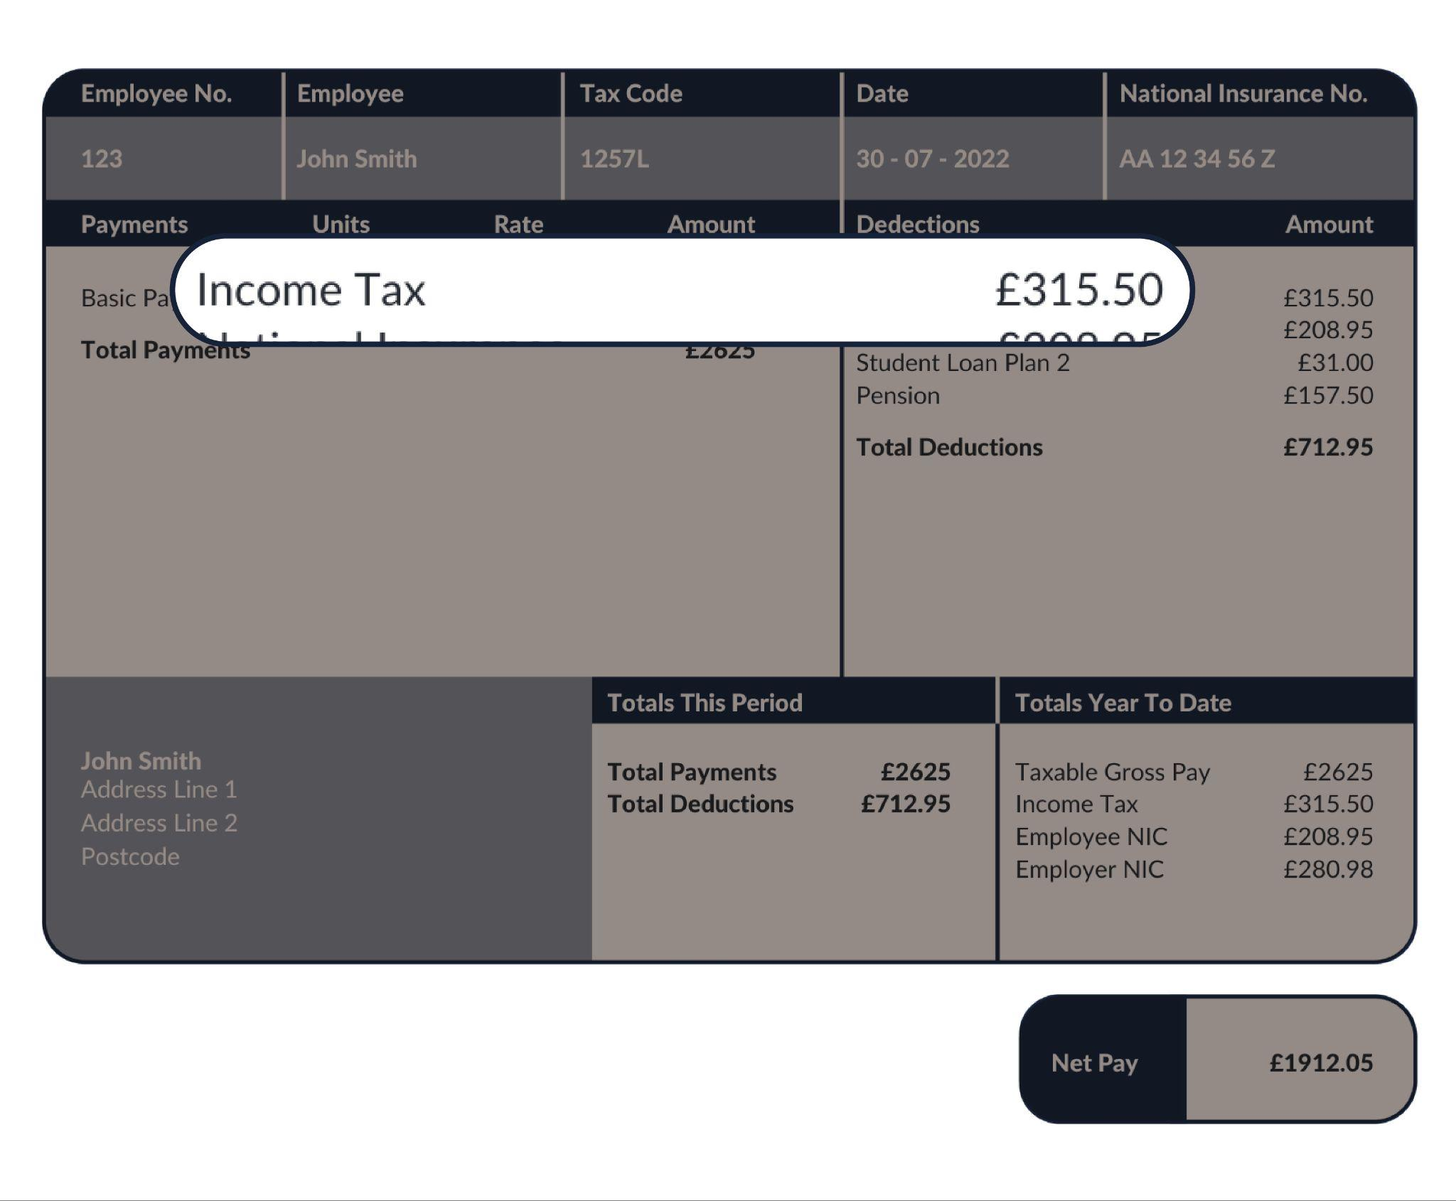
Starting with taxes
Income tax
Used for general public spending
The more a person earns, the more they pay
Why is it important to have this tax?

Slide 33
Income tax
Income tax
Key terms
Income tax = tax based on a person's earnings
Personal allowance = £12,570 (the amount a person can earn in a year before they pay any tax. This is non-taxable earnings)
Income tax is PROGRESSIVE. When a person earns more income, they go up a tax band so their rate of tax on each extra pound goes up. The key is that when a person gets paid over a certain amount, they only pay the higher level of tax on any money that sits in the new band.
We’ll see this in action later!

Slide 34
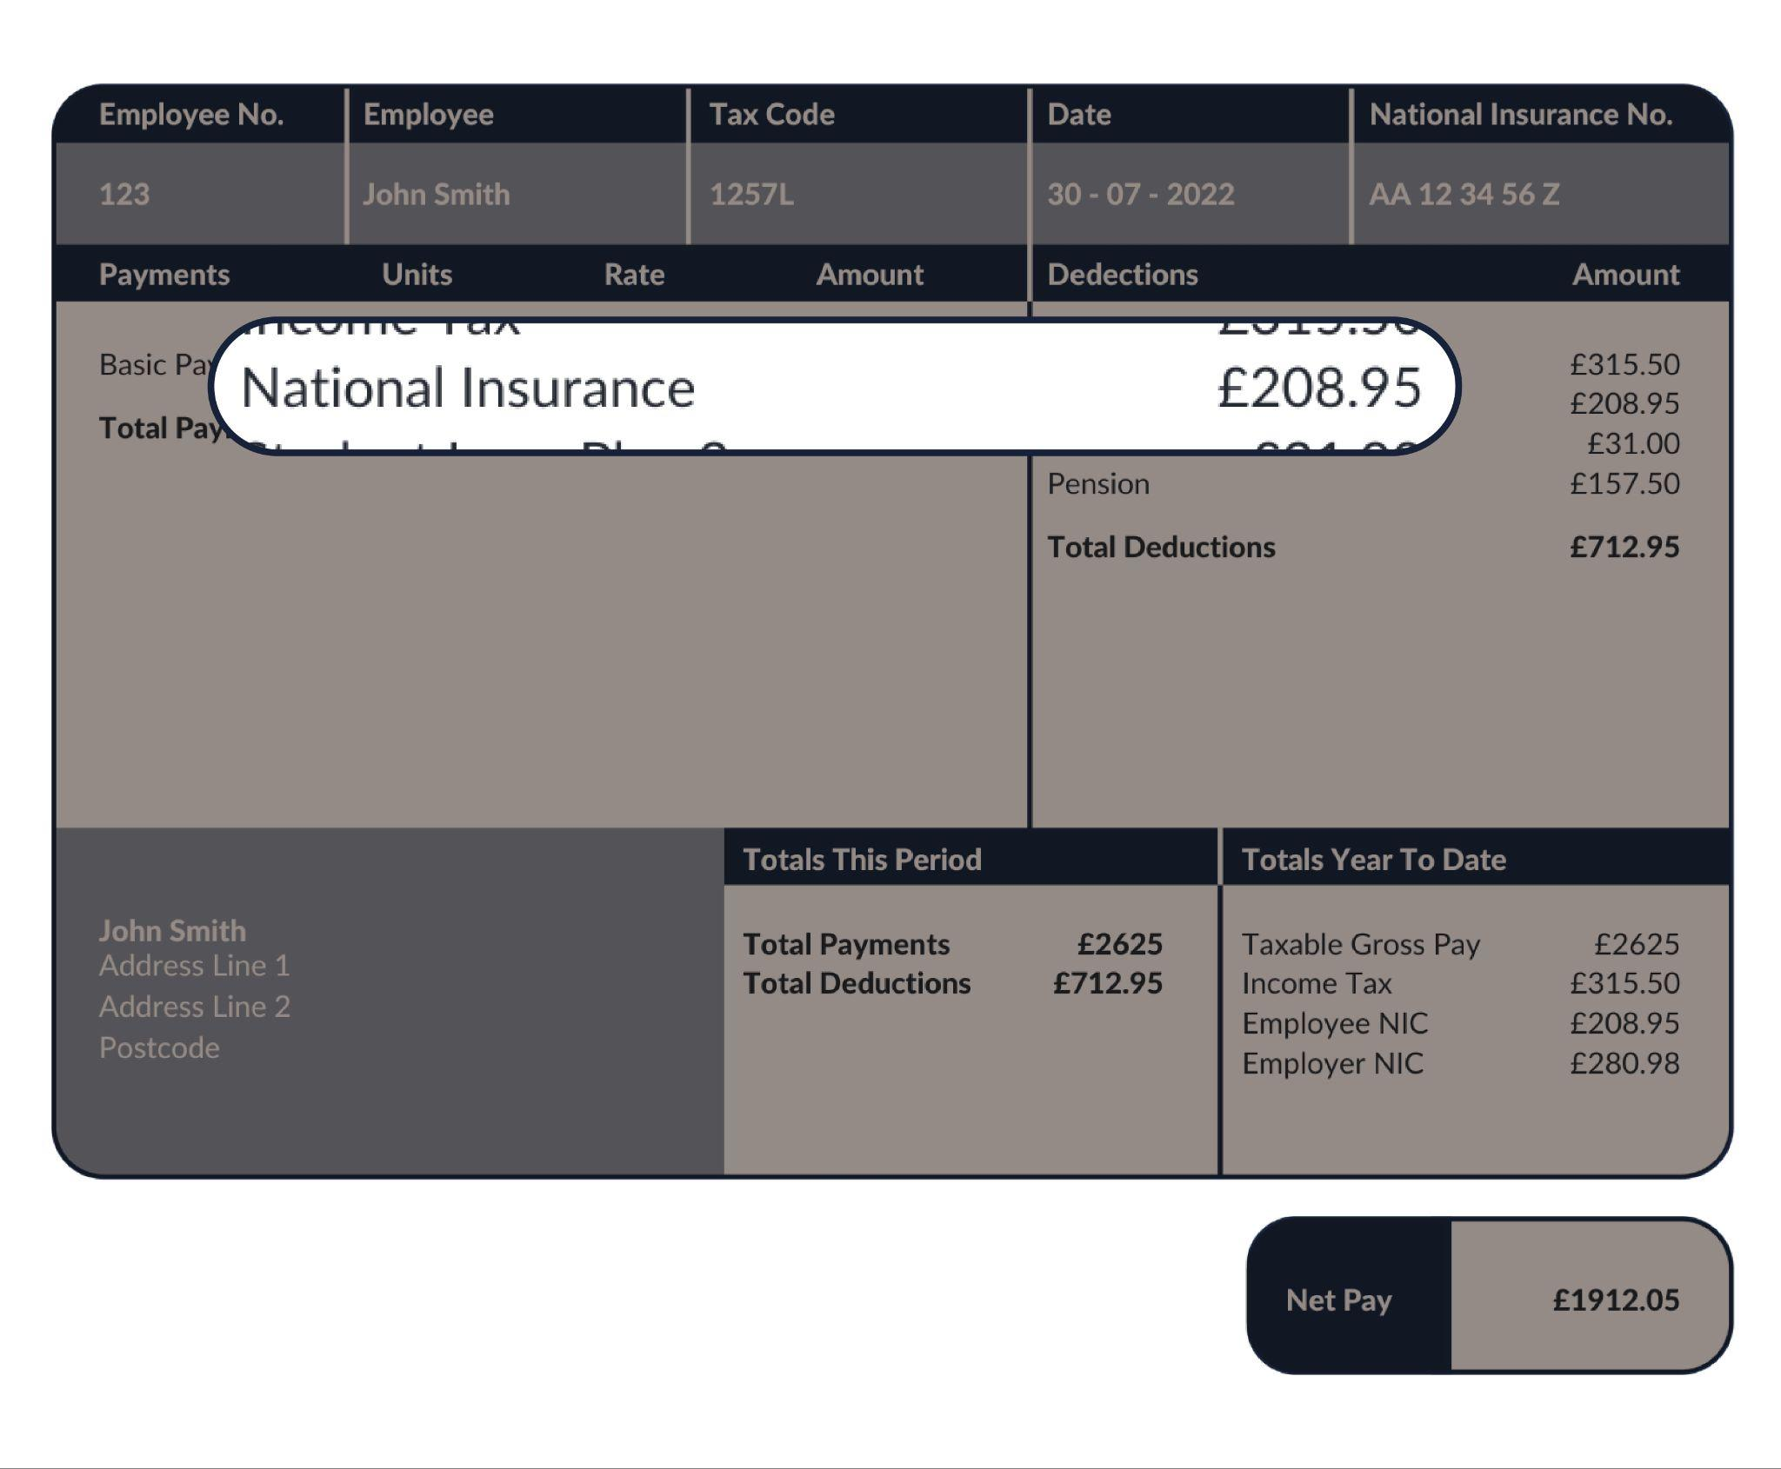
Starting with your taxes
National Insurance
Paid on earnings
Used for general public spending
The more you earn, the more you pay (to a point)
You need a minimum 35 years of paying this to qualify for a state pension
Used for general public spending
The more a person earns, the more they pay (to a point)

Slide 35
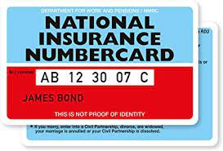
What is National Insurance (NI) all about?
A NI number is like a personal account number with the government and it NEVER changes
The number is needed for different applications e.g. when starting a job, if claiming benefits and taking a mortgage out. The list goes on!
Everyone pays National Insurance when they’re over 16 years old and earn or have self-employed profits over a certain amount, called a threshold.
Did you know?
Until 2011 cards were issued.
Now, a letter is sent in the post just ahead of a person’s 16th birthday!
Top tip! Take a pic of your National Insurance number

Slide 36
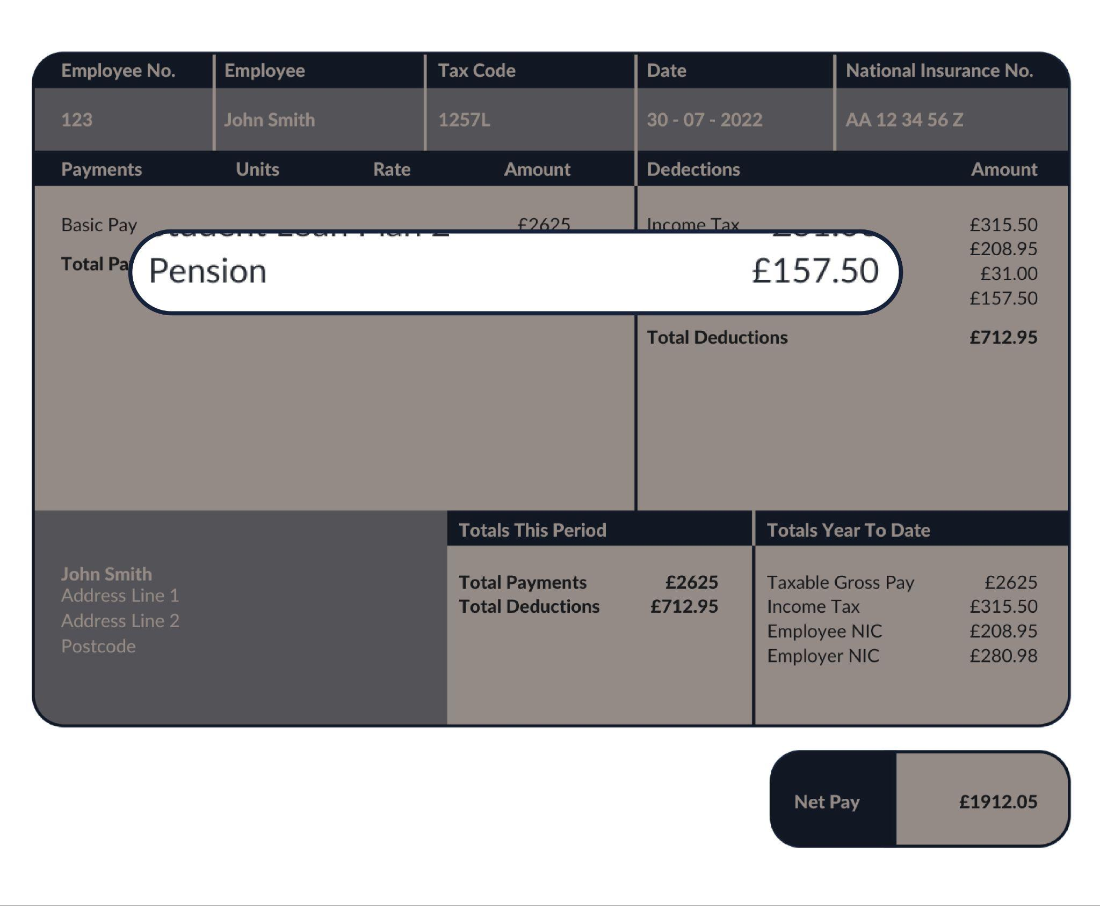
Other deductions
Pensions
Some people also pay into a pension, and their employer will contribute too
It goes towards a person’s income after they stop working in older age so it’s a way of saving money for later in life
It gets invested in the hope that it will grow
You can use it when you retire, from the age of 55 and moving to 57 from 2028

Slide 37
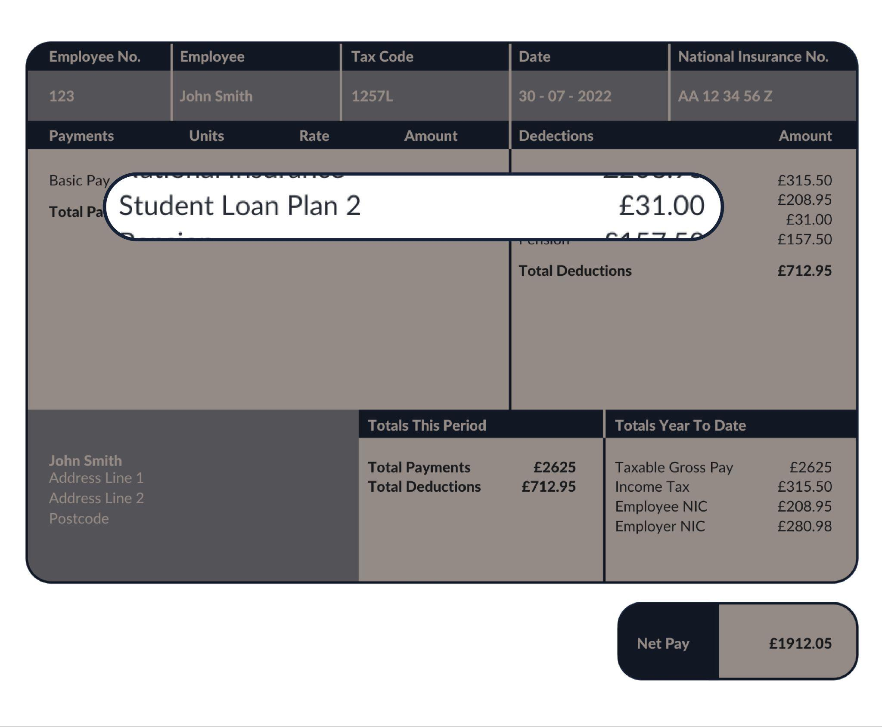
Other deductions
Student Loan
Money borrowed to pay for university education
It is paid back through salary deductions. The deduction is based on how much you earn, not how much you borrow

Slide 38
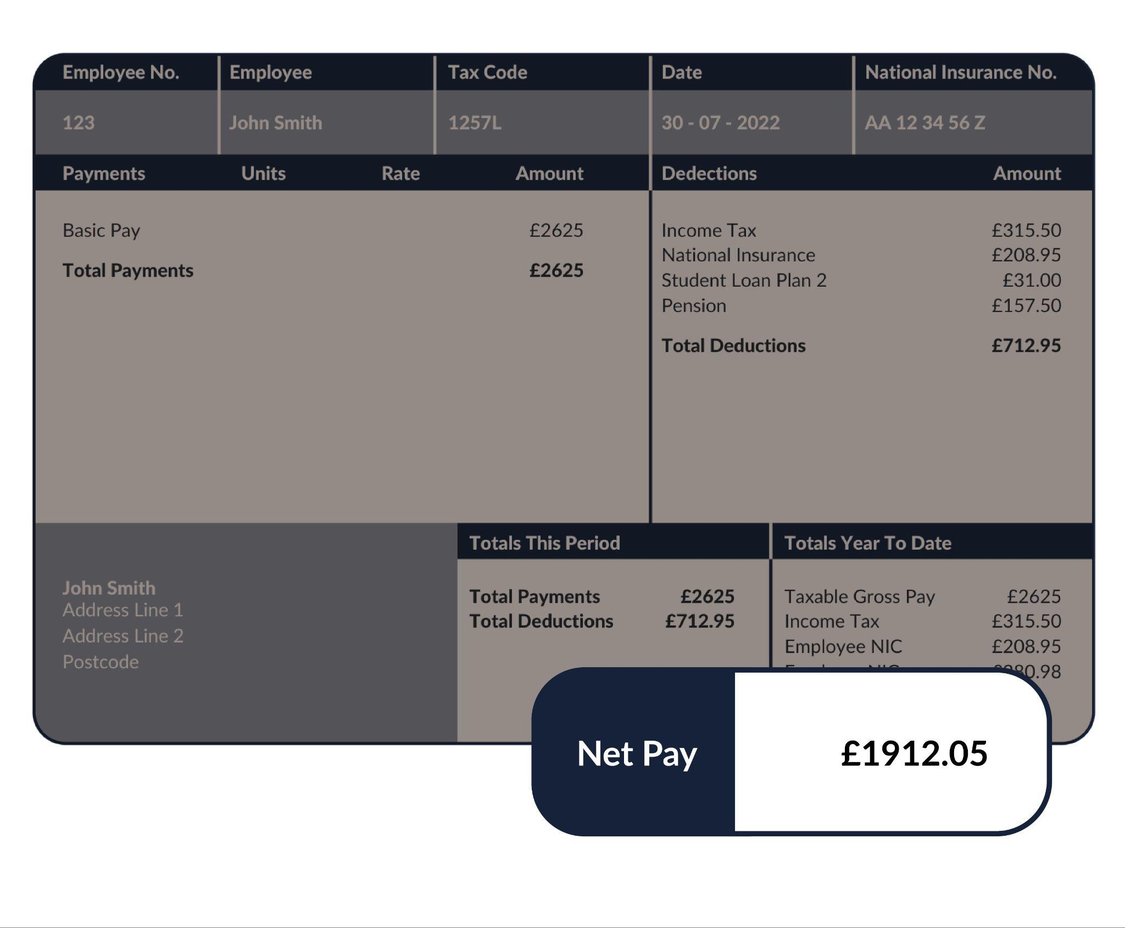
Starting with taxes
Net Pay
What’s left after deductions have been made

Slide 39
Calculating monthly pay
After tax has been deducted, how much money will a person make?
Monthly take home pay (NET pay)
Monthly NET pay = (Income – income tax – national insurance) ÷ 12 (months in a year)

Slide 40
Activity | Fill in the gaps using the word bank
When Darren gets a job as a lawyer and is told his annual salary, each month he works out his (1)………………….. by taking his total annual salary and dividing it by twelve. There are then several (2)………………….., which are amounts of money taken away from gross pay. The biggest deduction is usually
(3) …………….……, which is a tax that goes up the more he earns. This is known as a (4)........................................ This is collected and spent on things like the NHS, (5)........................................
Because Darren has been to university and took out a (6)................, he will need to pay chunks of this out on a monthly basis; he also chose to get a (7)............, which means he has a way of saving money for later in life.
Finally he is left with his (8)………..…….. which is a very important number because it’s the amount that comes into his bank account. He will then use this number to help him budget!
Wordbank
progressive tax education and transport deductions monthly gross pay
net pay pension student loan income tax

Slide 41
ANSWERS | Fill in the gaps using the word bank
When Darren gets a job as a lawyer and is told his annual salary, each month he works out his monthly gross pay by taking his total annual salary and dividing it by twelve. There are then several deductions, which are amounts of money taken away from gross pay. The biggest deduction is usually income tax, which is a tax that goes up the more he earns. This is known as a progressive tax. This is collected and spent on things like the NHS, education and transportation.
Because Darren has been to university and took out a student loan, he will need to pay chunks of this out on a monthly basis; he also chose to get a pension, which means he has a way of saving money for later in life.
Finally he is left with his net pay, which is a very important number because it’s the amount that comes into his bank account. He will then use this number to help him budget!
Wordbank
progressive tax education and transport deductions monthly gross pay
net pay pension student loan income tax

Slide 42
Calculating income tax
We’re going to take a deep dive into income tax, so that we understand how it works in reality!
Get ready to be income tax experts in just a bit.
Before handing over to you to calculate income tax for different jobs, we will practice using a worked example together.

Slide 43
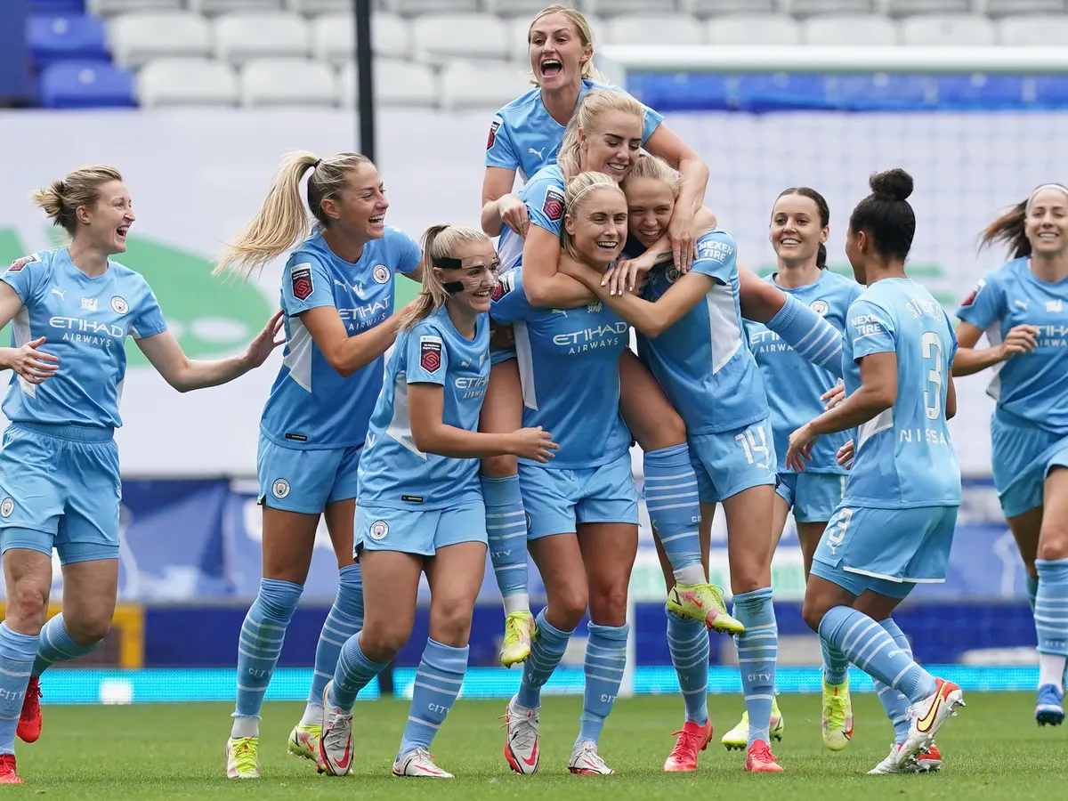
How much annual income tax does a Man City female player pay?
Each football player earns on average £75,000 per year
How much does a player pay in income tax on £75,000?
We’re going to explore this looking at tax bands.
Governments will change these rates and bands over time, so always check for yourself!
Notes:
https://www.bbc.co.uk/news/entertainment-arts-62133808

Slide 44
For a £75,000 salary, how do the tax bands work?
No tax is paid on the first £12,570!
Personal Allowance
* People earning over £100,000 gradually lose their entitlement to their personal allowance. The Personal Allowance goes down by £1 for every £2 of income above the £100,000 limit. These rates and bands can change so always check for yourself.
Please note: tax bands are changing from April 2023 and will be reflected in FLIC materials.

Slide 45
For a £75,000 salary, how do the tax bands work?
No tax is paid on the first £12,570!
Personal Allowance
Basic Rate
* People earning over £100,000 gradually lose their entitlement to their personal allowance. The Personal Allowance goes down by £1 for every £2 of income above the £100,000 limit. These rates and bands can change so always check for yourself.
20% tax is paid on income between £12,571 and £50,270
Please note: tax bands are changing from April 2023 and will be reflected in FLIC materials.

Slide 46
How do the tax bands work?
No tax is paid on the first £12,500!
Finally, we see that her salary lies in the Higher Rate tax band.
So 40% tax is paid on the difference between £50,271 and £75,000
Personal Allowance
Basic Rate
Basic Rate
Higher Rate
20% tax is paid on income between £12,571 and £50,270
Please note: tax bands are changing from April 2023 and will be reflected in FLIC materials.

Slide 47
Own your income tax!
Worked example with annual salary of £75,000
Tax rates and bands | What’s taxable? | Tax to pay
Personal allowance at 0% £0 to £12,570 | £0 to £12,570 (for income less than £100,000) | 0 x £12,570 = £0

Slide 48
Own your income tax!
Worked example with annual salary of £75,000
Tax rates and bands | What’s taxable? | Tax to pay
Personal Allowance at 0% £0 to £12,570 | £0 to £12,570 (for income less than £100,000) | 0 x £12,570 = £0
Basic Rate at 20% £12,571 to £50,270 | £50,270 - £12,571 = £37,699 | 0.20 x £37,699 = £7,539.80

Slide 49
Own your income tax!
Worked example with annual salary of £75,000
Tax rates and bands | What’s taxable? | Tax to pay
Personal Allowance 0% £0 to £12,570 | £0 to £12,570 | 0 x £12,570 = £0
Basic Rate at 20% £12,571 to £50,270 | £50,270 - £12,571 = £37,699 | 0.20 x £37,699 = £7,539.80
Higher Rate at 40% £50,271 to £125,140 | £75,000 - 50,271 = £24,729 | 0.40 x £24,729 = £9,891.60
The salary falls in this tax band
* People earning between £100,000 and £125,000 gradually lose their entitlement to their personal allowance. By the time they reach £125,000, the personal allowance is gone and everything they earn up to £50,270 is taxed 20%

Slide 50
Own your income tax!
Worked example with annual salary of £75,000
Tax rates and bands | What’s taxable? | Tax to pay
Personal Allowance at 0% £0 to £12,570 | £0 to £12,570 (for income less than £100,000) | 0 x £12,570 = £0
Basic Rate at 20% £12,571 to £50,270 | £50,270 - £12,571 = £37,699 | 0.20 x £37,699 = £7,539.80
Higher Rate at 40% £50,271 to £125,140 | £75,000 - 50,271 = £24,729 | 0.40 x £24,729 = £9,891.60
Additional Rate at 45% Over £125,140 | No income tax paid at this rate | No income tax paid at this rate
Total income tax |  | £0 + £7,539.80 + £9,891.60 = £17,431.40

Slide 51
Own your income tax!
Quick quiz on tax bands
Which tax band(s) do these incomes fall in?
David earns £42,000 a year
Jorge earns £55,000 a year
The Managing Director of David’s bank, Andrea, earns £160,000 a year
Ken earns £35,000 a year
Zara earns £12,000 a year
Tax rates and bands | Threshold (from April 2022 to April 2023)
Personal Allowance 0% | £12,570
Basic Rate 20% | £12,571 to £50,270
Higher Rate 40% | £50,271 to £125,140
Additional Rate 45% | Over £125,140
ANSWERS | Which tax band(s) do these incomes fall in?
Basic rate tax band
Basic rate and some income in Higher rate tax band
Basic rate, Higher rate and some income in Additional rate tax band
Basic rate tax band
It’s within the Personal allowance so she pays no income tax
Notes:
Teacher guidance notes:
Ask student to draw the continuum line (bottom right image) to support their thinking. This activity should be used to highlight the misconception that when your salary falls in e.g. a Higher rate tax band, not ALL of your salary is taxed at the higher rate of 40%, but the amount that sits in the new band.
This quiz acts as a scaffold and support before the income tax calculations worksheet. For students that you see are less confident, encourage them to choose lower salary jobs when they begin the worksheet. Vice versa for more confident students.

Slide 52
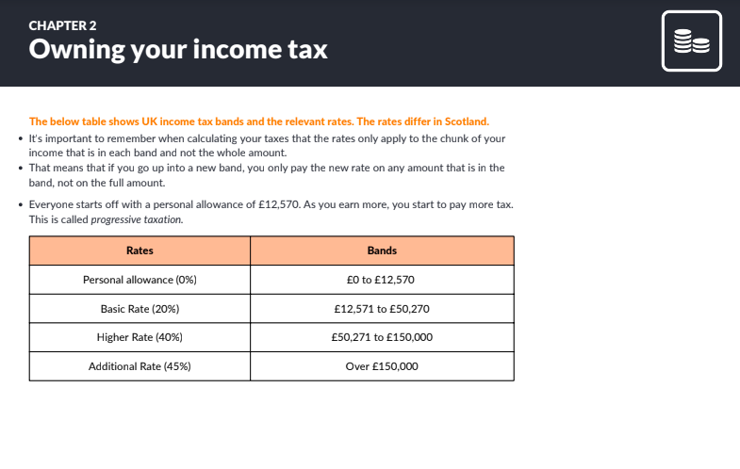
Calculating annual income tax
How much income tax does a person pay for different salaries?
Choose 1-2 jobs from the list given and calculate the income tax
Resource 4: Owning your income tax

Slide 53
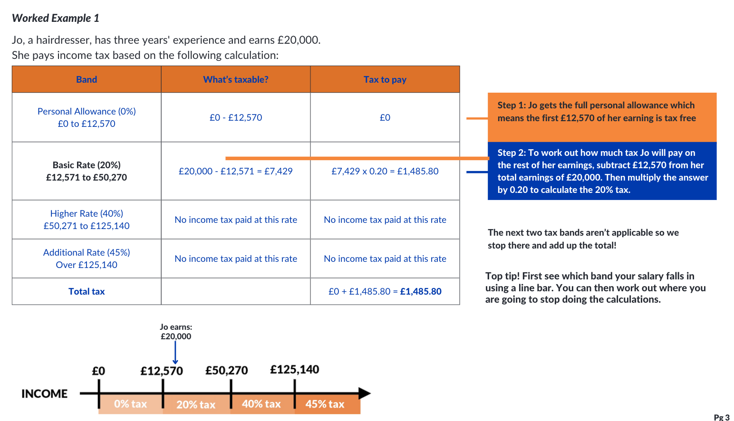
Worked example | Calculating monthly pay

Slide 54
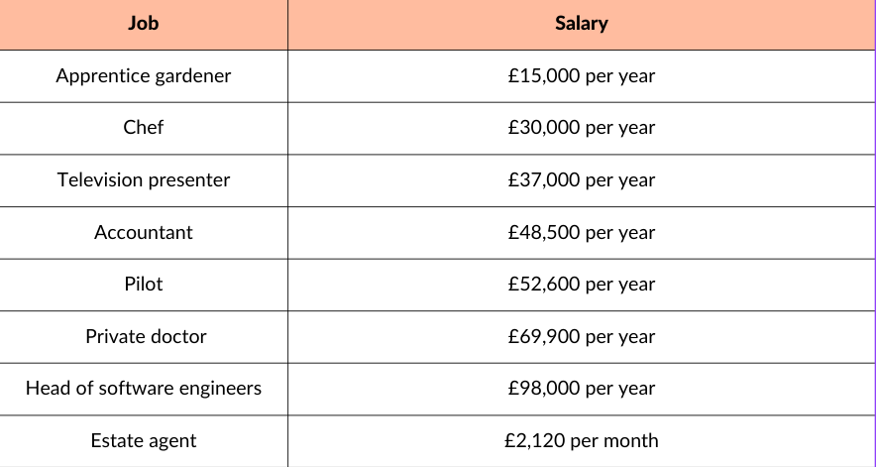
Discussion and answers
What have you noticed about the income tax you’ve calculated? How does it change when the salary is just above or below the tax band?
Job | Annual income tax
Apprentice gardener | £485.80
Chef | £3,485.80
Television presenter | £4,885.80
Accountant | £7,185.80
Pilot | £8,471.40
Private doctor | £15,391.40
Head of software engineers | £26,631.40
Estate agent | £2,573.80 (£214.50 per year)
Allow £1 above or below answers for rounding differences.
Please note: tax bands are changing from April 2023 and will be reflected in FLIC materials.
Notes:
Key points to draw out from students
The apprentice gardener’s income tax is very small compared to the other jobs because most of the income is not taxed as it falls in the personal allowance category
Annual income tax

Slide 55
Optional | Multiple choice Q1
Who is in charge of collecting tax for the whole country?
A | B | C
HMRC (His Majesty’s Revenue and Customs) | Local councils | The Chancellor of the Exchequer

Slide 56
Optional | Multiple choice Q1
Who is in charge of collecting tax for the whole country?
A | B | C
HMRC (His Majesty’s Revenue and Customs) | Local councils | The Chancellor of the Exchequer

Slide 57
Optional | Multiple choice Q2
2. In the UK income tax rates are progressive, meaning
A | B | C
A person pays the same proportion no matter how much they earn | The more someone earns, the less they pay | The more someone earns, the more they pay

Slide 58
Optional | Multiple choice Q2
2. In the UK income tax rates are progressive, meaning
A | B | C
A person pays the same proportion no matter how much they earn | The more someone earns, the less they pay | The more someone earns, the more they pay

Slide 59
Optional | Multiple choice Q3
3. If a person is self employed,
A | B | C
They are responsible for completing their own self assessment tax return | HMRC will write to them to let them know how much tax to pay | They need an accountant to complete the self-assessment tax return form

Slide 60
Optional | Multiple choice Q3
3. If a person is self employed,
A | B | C
They are responsible for completing their own self assessment tax return | HMRC will write to them to let them know how much tax to pay | They need an accountant to complete the self-assessment tax return form

Slide 61
Optional | Multiple choice Q4
4. The majority of tax in the UK is spent on
A | B | C
Defence | Social protection (including pensions and welfare benefits) | Health

Slide 62
Optional | Multiple choice Q4
4. The majority of tax in the UK is spent on
A | B | C
Defence | Social protection (including pensions and welfare benefits) | Health

Slide 63
Optional | Multiple choice Q5
5. If a person is taxed wrongly (i.e. overpaid or underpaid)
A | B | C
HMRC will immediately pick it up and call the person | Their employer is responsible for correcting the mistake | They are responsible for calling HMRC and resolving the mistake

Slide 64
Optional | Multiple choice Q5
5. If a person is taxed wrongly (i.e. overpaid or underpaid)
A | B | C
HMRC will immediately pick it up and call the person | Their employer is responsible for correcting the mistake | They are responsible for calling HMRC and resolving the mistake

Slide 65
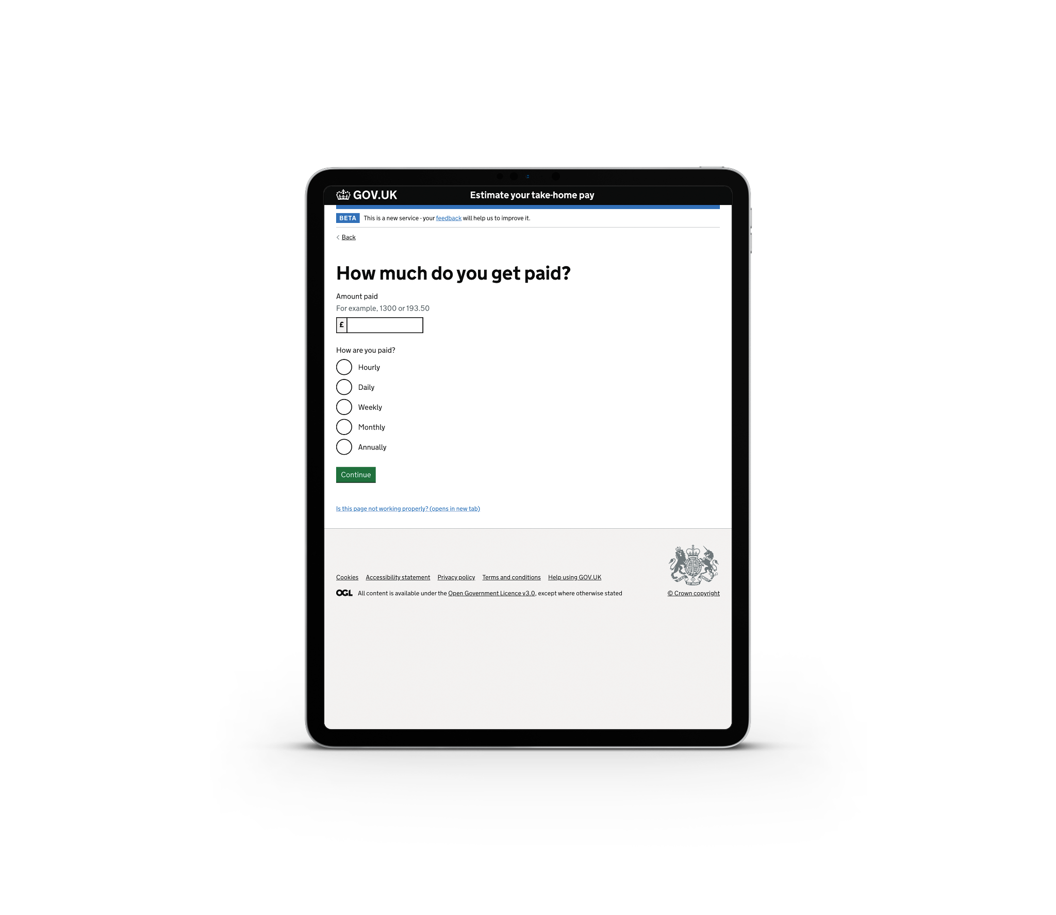
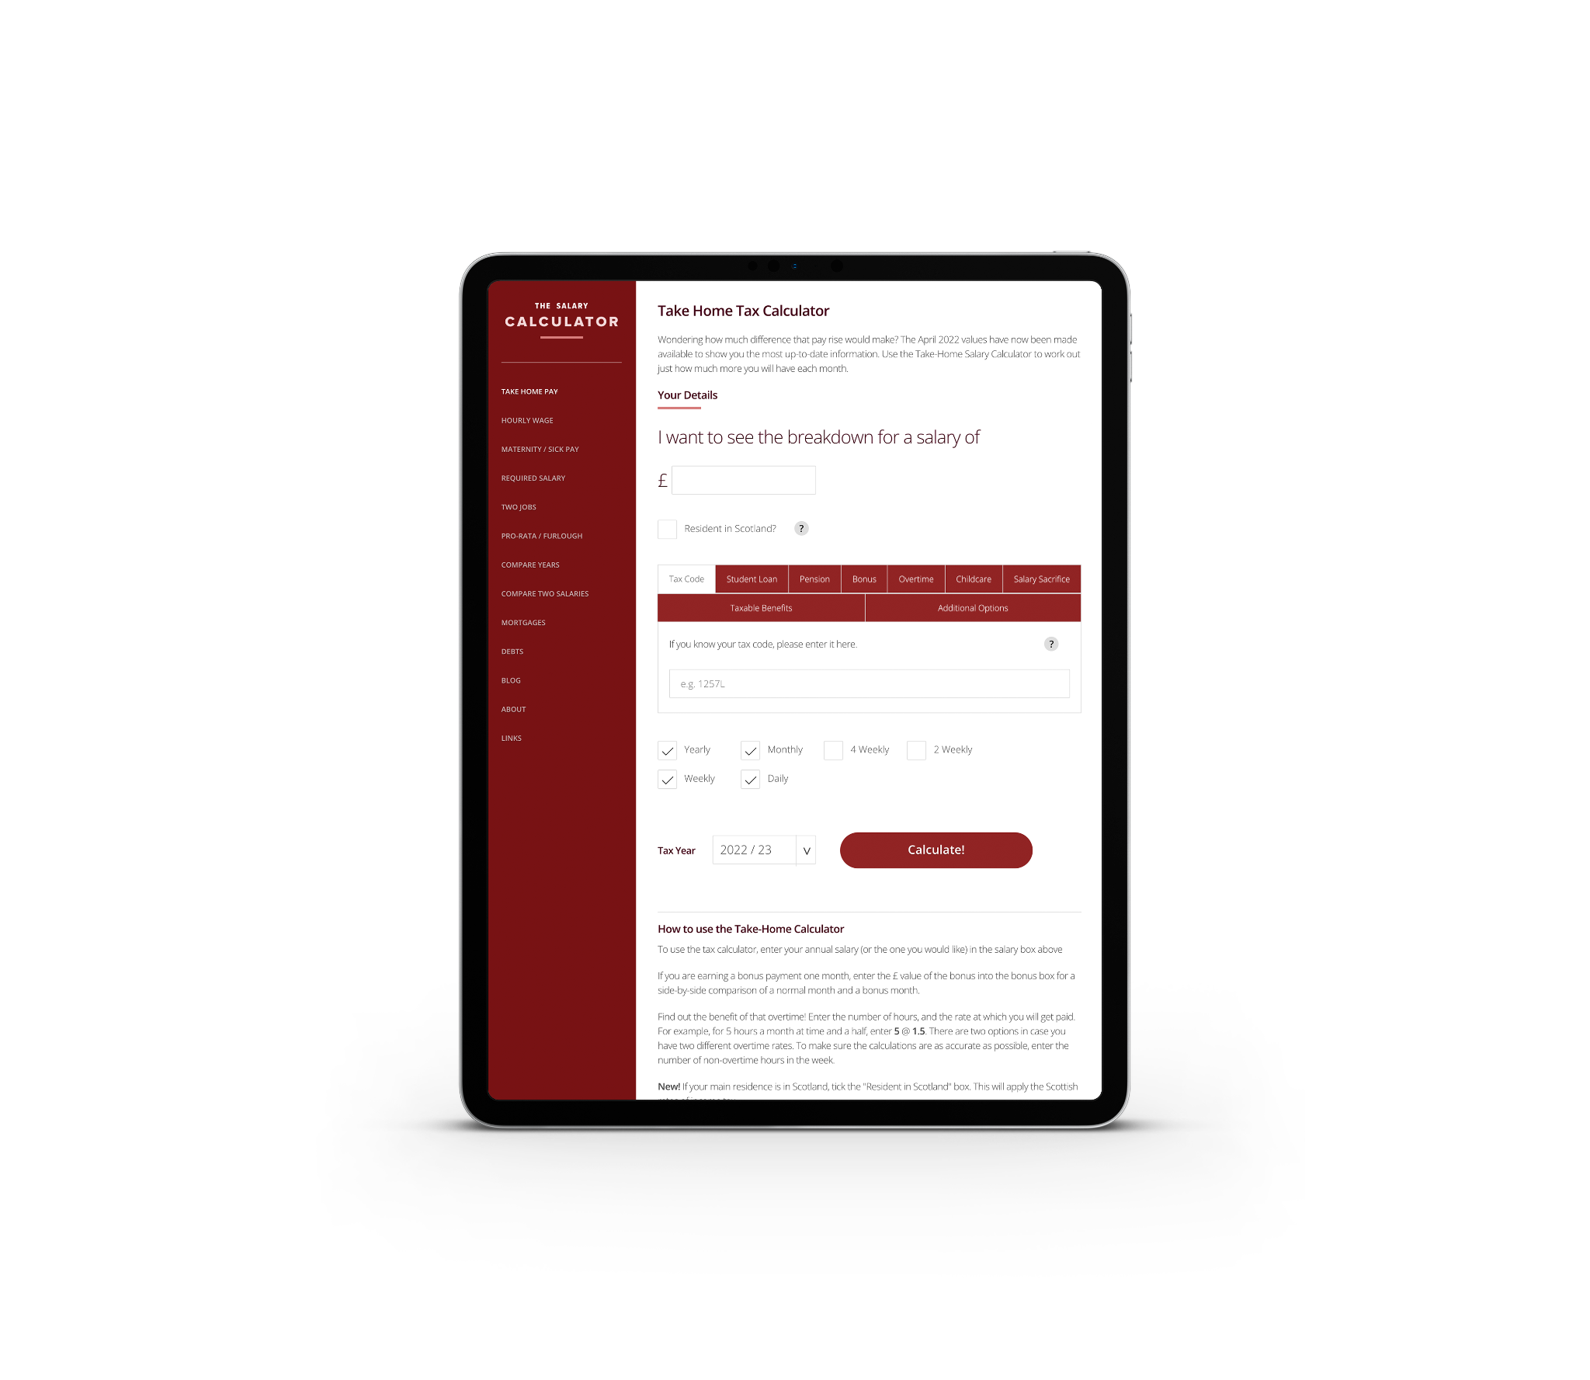
Where can I go for some online support working out my deductions?
Government website
The Salary Calculator
Listen to Tax Man

Slide 66
Any questions?
?

Slide 67
Learning Outcome: To learn about different forms of employment, about tax and other deductions that may be taken from earnings, as well as how to speak up at work.
By the end of the session, students will be able to:
Analyse the advantages and disadvantages of different ways to make money and important factors to consider when choosing a job.
Explain the main salary deductions, and calculate income tax.
State rights at work regarding fair treatment and pay, and identify where to turn for support when facing problems in the workplace.

Slide 68
Chapter 3:
Speaking up

Slide 69
Everyone in the UK is paid and taxed the same.
How true is this statement?

Slide 70
Everyone in the UK is paid and taxed the same.
National minimum wage changes according to age and some industries show evidence of a gender pay gap
Scotland as a devolved power has different tax rates from the UK
National minimum wage | Living wage
Your income tax is calculated based on how much you earn

Slide 71
Learning Outcome: To learn about different forms of employment, about tax and other deductions that may be taken from earnings, as well as how to speak up at work.
By the end of the session, students will be able to:
Analyse the advantages and disadvantages of different ways to make money and important factors to consider when choosing a job.
Explain the main salary deductions, and calculate income tax.
State rights at work regarding fair treatment and pay, and identify where to turn for support when facing problems in the workplace.

Slide 72
The Equality Act
The Equality Act 2010 legally protects people from discrimination in the workplace and in wider society.
There are different types of discrimination. It is against the law to discriminate against anyone because of:
Age, sex or disability
religion or belief
sexual orientation
being married/ in a
civil partnership
These are called ‘protected characteristics’...
gender reassignment
being pregnant or on maternity leave
race including colour, nationality, ethnic or national origin

Slide 73
Equal pay for equal work!
Are all characteristics protected?
How does watching this video make you feel? Are there any trends in the kinds of work that we expect men/ women to do? How do you think the gender pay gap can be closed?
What can someone do if they are not being paid fairly?

Slide 74
Asking for a pay rise
CAN you ask for a pay rise?
Can or should any of the following matter? -type of work, level of experience, national economics i.e. recession, (in)equality amongst workers.

Slide 75
Asking for a pay rise
SHOULD you ask for a pay rise?
Can or should any of the following matter? -type of work, level of experience, national economics i.e. recession, (in)equality amongst workers.

Slide 76
Top tips when asking for a pay rise
Prepare key points before booking your meeting with your manager
Be specific when it comes to the value of your work, both in terms of what you have achieved and how you have achieved results
Use facts where you can e.g. “My work led to a 10% increase in sales last year”
Demonstrate the value you will bring to your employer in the future
Discuss your soft skills and how you add value internally to the company e.g. have you organised a volunteers’ day, or supported colleagues through problems?
Use clear and concise language

Slide 77
Making a case for a pay rise
In pairs, you’re going to pick the strongest arguments for a pay rise pitch using either Nic or Naomi.
Make your case to each other (5 mins to prep, 2 mins each to share). How convincing can you be?
Naomi
Marketing manager at top fashion brand
Nic
Shop manager at major sports brand

Slide 78
Making a case
Meet Naomi
Naomi works in the marketing department at a large fashion brand. At the start of the year she was involved in a big project that led to a £200,000 increase in the company’s profit. But she hasn’t had a pay rise since she started working there three years ago. Furthermore, two members of the team left and were not replaced, so Naomi has picked up their work too, working over her contracted hours at least a couple of days a week.
What should Naomi say to her boss?
Task - can you identify the key points for her pay rise pitch?
After 5 minutes of writing, pitch to one another…

Slide 79
Making a case
Meet Nic
Nic works as a shop manager at a big sports brand. He has been working at the company for five years and is well liked by both his shop assistants and customers. He always seems to resolve problems and has increased clothes sales for the company by 12% over the past year. Yet, he received only a small pay rise when he was promoted to shop manager. He’s been offered a job at a competitor sports brand for a higher salary but is keen to stay as he enjoys the people he works with and has a good work/life balance.
At the same time, over the past year, inflation has risen by 9% meaning a lot of his costs and the things he buys have become much more expensive. He’s noticed the cost of petrol, his weekly food shop and heating bill rise a lot! In order to be convinced to stay in his current role, Nic is looking for a pay rise.
What should Nic say to his boss?
Task - can you identify the key points for his pay rise pitch?
After 5 minutes of writing, pitch to one another…

Slide 80
Making a case
Meet Naomi - points to consider
Naomi works in the marketing department at a large fashion brand. At the start of the year she was involved in a big project that led to a £200,000 increase in the company’s profit. But she hasn’t had a pay rise since she started working there three years ago. Furthermore, two members of the team left and were not replaced, so Naomi has picked up their work too, working over her contracted hours at least a couple of days a week.
What should Naomi say to her boss?
Task - can you identify the key points for her pay rise pitch?
After 5 minutes of writing, pitch to one another…

Slide 81
Making a case
Meet Nic - points to consider
Nic works as a shop manager at a big sports brand. He has been working at the company for five years and is well liked by both his shop assistants and customers. He always seems to resolve problems and has increased clothes sales for the company by 12% over the past year. Yet, he received only a small pay rise when he was promoted to shop manager. He’s been offered a job at a competitor sports brand for a higher salary but is keen to stay as he enjoys the people he works with and has a good work/life balance.
At the same time, over the past year, inflation has risen by 9% meaning a lot of his costs and the things he buys have become much more expensive. He’s noticed the cost of petrol, his weekly food shop and heating bill rise a lot! In order to be convinced to stay in his current role, Nic is looking for a pay rise.
What should Nic say to his boss?
Task - can you identify the key points for his pay rise pitch?
After 5 minutes of writing, pitch to one another…

Slide 82
Making a case for a pay rise
Class vote - Who should get a pay rise?
Naomi
Marketing manager at top fashion brand
Nic
Shop manager at major sports brand
Notes:
Teacher instruction

Slide 83
Request declined
What individuals or organisations are available to help with work-related issues?

Slide 84
Resolving Pay Problems
People or organisations you should get to know.
Match the definition to the organisation!

Slide 85
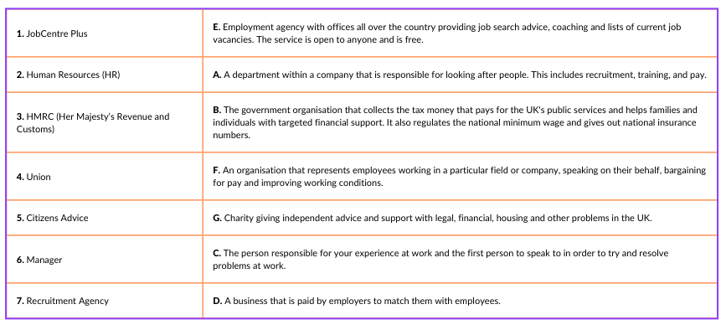
Resolving Pay Problems
ANSWERS | People or organisations you should get to know

Slide 86
Resolving Pay Problems
Who should you speak to? Match the 8 scenarios to the 8 blue answer cards

Slide 87
Resolving Pay Problems
ANSWERS | Who should you speak to?

Slide 88
Learning Outcome: To learn about different forms of employment, about tax and other deductions that may be taken from earnings, as well as how to speak up at work.
By the end of the session, students will be able to:
Analyse the advantages and disadvantages of different ways to make money and important factors to consider when choosing a job.
Explain the main salary deductions, and calculate income tax.
State rights at work regarding fair treatment and pay, and identify where to turn for support when facing problems in the workplace.

Slide 89
Finances and Wellbeing
For many families managing finances and budgeting from net pay has been difficult because of inflation. Inflation is when prices rise, and inflation has been rising a lot, reducing purchasing power (how far money can go in terms of spending).
Remember that inflation changes over time and this period will not last forever.
As you have learnt, there are things that people can do to adjust their budgets including reconsidering what things are needs and wants.
There are many sources of advisory services and help for families who are experiencing financial difficulties.

Slide 90
Services available for people who have concerns about their personal finances
Citizens Advice – Debt and Money – This resource contains links to advice on a number of topics, including financial difficulties, cost of living and communicating with creditors.
National Debtline – Debt and Money – a debt advice charity run by the Money Advice Trust, offering a free and confidential debt advice service.
NSPCC Helpline 0808 800 5000
Childline Helpline 0800 1111
At school, you can speak with an adult you trust.
This could be your form tutor, head of year or the school’s safeguarding officer.

Slide 91
Links to learn more!
Articles to extend learning
How does UK tax work? (Youtube ‘Joe Georgekutty’, Sept 2020)
What are the tax implications of earning over £100,000? (TaxScouts, July 2022)
Difference between sole trade and limited company (Youtube ‘Pennies to Pounds’, Nov 2020)
A guide to the living wage (Living Wage Foundation)
Benefits checker/calculator and grants finding website which also has useful info about benefits. (Turn to Us, UK National Charity)
BBC Sounds - Should we be more open about salaries?
Please visit the FLIC learning hub - https://ftflic.com/learning-hub/ for further resources

Slide 92
Over to you…
What are the three most
important messages that you have learnt about getting paid that you will use in the future?
Consider your employment, payslip and resolving pay problems at work knowledge

