Slide 1
How to understand cryptocurrency
This session is aimed at key stage four and five (recommended for Years 9, 10, 11, 12 and 13)

Slide 2
‘I will learn how cryptocurrency assets work and how to assess the risks and opportunities that they present’
By the end of the session, I will be able to:
Define what cryptocurrency is and describe how it compares with traditional money
Recognise the influence of social media and peers on financial decisions
Confidently identify the risks that cryptocurrencies present
Explain the warning signs of cryptocurrency scams and what to do when they are spotted

Slide 3
Contents
Chapter 1 Different types of money and their uses
Chapter 2 Factors influencing our financial decisions
Chapter 3 Research and making informed decisions

Slide 4
01 What is FLIC?
02 What is money?
03 Saving vs investing
04 What is cryptocurrency?
05 Evaluating cryptocurrency
BREAK
06 Who does cryptocurrency appeal to?
07 Social media, red flags and cryptocurrency
08 How to manage external influences
BREAK
09 What is good research?
10 Researching cryptocurrency
11 Making informed decisions

Slide 5
What is FLIC?
The Financial Times news group has set up a charity called the Financial Literacy and Inclusion Campaign, which focuses on building up the financial knowledge and skills of everyone in the UK, especially people that do not usually come across this information.

Slide 6
Chapter 1:
Different types of money and their uses
What is money?

Slide 7
What is money?
Mindmap all ideas you have related to money
What is money?
How do people use money?
How do people decide what money is worth?
Who decides what money is worth?
What do people use money for?
Are there any alternatives to money?
Resource 1: A3 Mindmap Sheet

Slide 8
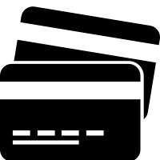
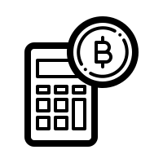
What is money?
The concept of money has evolved over time. Historically, money has been linked to other tangible commodities, such as shells or silver coins. Changes in value have led to the introduction of “paper” money and “plastic” money (cards), as well as digital currencies.

Slide 9
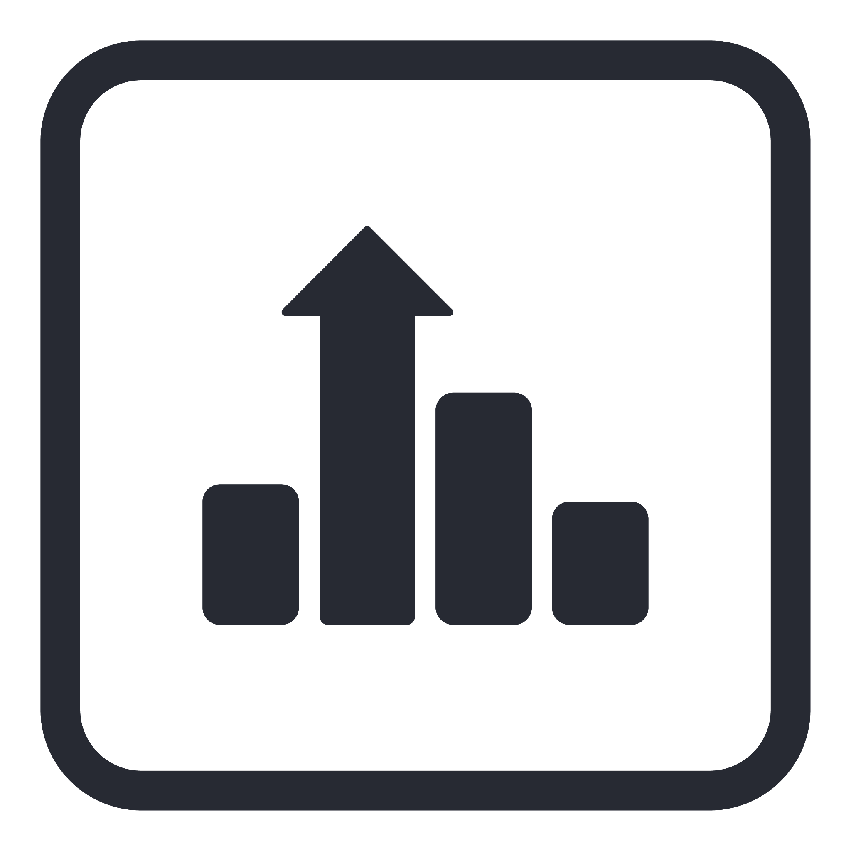
What are the 3 main things people
do with their money?
Spend it
Money will be spent on needs and wants
Save it
Money can be saved for future spending
Invest it
Money can be invested to try and make more of it. This comes with risk and no guarantee of more money made
Notes:
Teacher explanation
When you get money, lots of it will go on things like paying for housing, food, clothes, nights out and other things you need and want.
The money that you don’t spend can be used for saving, or for investing.

Slide 10
What are the differences between
saving and investing?
Notes:
Teacher Explanation of savings vs investing
Saving generally means putting your money someplace safe, where you know you will definitely get it back. In the past, some people kept cash under their mattresses. Most people keep their savings in a bank.
The bank will pay you if you keep your savings there. Payment for the savings - known as interest - will change depending on the interest rates set by the central bank. Over the past few years, interest rates have been low e.g. if you put £100 in a bank account, you’d be lucky to earn £1 a year. However this is changing at the moment.
If you want to earn more than that, the next step is investing.
There are lots of ways to invest.
You can buy bonds, which is like lending money to the government, or to companies. The riskier the government or company, the more you’ll be paid. But … if the government or company goes bust, you could lose some or all of your money.
Another thing you can do is buy shares that give you a tiny part of the ownership of public companies like Apple or Tesco. Shares are usually riskier than bonds, since if a company goes bust/bankrupt, it pays off its loans first, and then splits whatever is left between its owners.
If you buy shares, some companies will pay you a small amount of money every year, known as a dividend.
Shares can also go up in value, sometimes by quite a lot. If you’d bought an Apple share five years ago, it would have cost you about $30, and it would be worth more than $160 today.

Slide 11
Investing is the act of placing money into an asset* with the hope that the asset increases in value.
Savings are a part of income set aside for future use.
Saving and Investing
Why do people invest?
*An asset is a resource that holds some significant value e.g. houses, stocks, shares and bonds. Most investors buy assets with the expectation that these assets will rise in value over a period of time.
Notes:
Teacher Explanation of ‘why do people invest’?
This all depends on what you are investing in.
When people invest in items, it could be because of a hobby or passion they have. This could also be linked to developing a skill like home renovations.
Ultimately, investments allow for your money to have the potential to grow. People generally build wealth to prepare for and safeguard their future. This is especially important as people are living for longer and inflation rises.
Ask students to discuss their ideas for one minute with the person next to them before sharing with the group.
Consolidate the ideas about the purpose of investing:
-Beat inflation
-Grow wealth
-Create another stream of (passive) income
-Achieve financial goals faster
-Save for retirement

Slide 12
What is cryptocurrency?
Describe what you know about cryptocurrency using the words below: money coins digital investment risk bank
Currencies - a medium of exchange for goods and services.
A currency usually comes in the form of coins and notes, but now there are also digital currencies, such as cryptocurrency.
Bitcoin is the largest cryptocurrency, which we will therefore focus on in these lessons, but others exist (like Ethereum) and others have failed (like Luna).

Slide 13
Cryptocurrency v.s money overview
Why some are wary of cryptocurrency…
It doesn’t have the backing of a government or central bank and isn’t regulated
It isn't stable
It isn't accepted for buying most shopping items
…can be exactly why others prefer it
Its instability (also called volatility) allows some people to make huge gains in a short space of time, but also huge losses!
It is decentralised, meaning peer to peer trades can take place without an organisation in the middle
Notes:
An institutional body includes organisations such as banks or insurance companies.

Slide 14
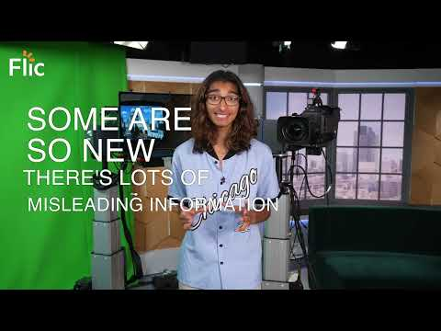
What is cryptocurrency?
5 facts about cryptocurrency:
Which of these facts are familiar to you?
Which are new to you?
Optional video resource explaining how bitcoin works : https://youtu.be/f7iXTyHGYX4 - play to 02:45

Slide 15
What is cryptocurrency?
Literacy resource
Cryptocurrency - bitcoin
Summarise your section of the handout into 30-50 words
Select two points to create a whole class bitcoin fact sheet
Stretch - Using two different colours, highlight the positives and negatives of cryptocurrency
Resource 2: Literacy Resource (recommended one page of handout given to each pair)
Notes:
Different sets of students to be given different sections to read and summarise. Students then feedback to the class.

Slide 16
Summary | What is cryptocurrency?
Cryptocurrencies have a limited number of coins. This limited supply gives them value. Bitcoin is limited to 21 million bitcoins. The amount of coins that exist need to be ‘mined’ by massive computers solving complicated maths problems.
The value of crypto is mostly based on what people believe the value of the cryptocurrency is or will be. It is not issues by the government, like the British pound or US dollar. This is why it can be very volatile - often changing in value.
Cryptocurrency is speculative. This means that people buy or trade crypto because they have heard it may rise in value, not because they have evidence to support a potential rise in its value. Unlike online games, like Fortnite, investments in cryptocurrency can lead to real big losses.
Cryptocurrencies, at the moment, are not widely accepted so can’t be used to buy a lot of items.
Any investment should only be made after an emergency fund has been set aside. This is an amount of money, usually 3 months worth of spending, saved in case of unforeseen events.
Notes:
Different sets of students to be given different sections to read and summarise. Students then feedback to the class.

Slide 17
Did you know?
Money that is made or lost on crypto assets is taxable!
Learn more here
Notes:
Different sets of students to be given different sections to read and summarise. Students then feedback to the class.

Slide 18
Blockchain
Blockchain is a type of technology made of a chain of blocks that contain information. When people trade, the information is recorded onto blocks. These records cannot be changed and are secured using something called ‘cryptography’. Blockchain allows people to trade with anyone around the world, without knowing them personally and without middlemen (like banks or other companies)
Not one person or organisation is ever in charge, so blockchain is known as a decentralised network, compared to a centralised network
Cryptocurrency is built using blockchain, but lots of other things can use blockchain technology too
What other ways can blockchain can be used?
Notes:
Further context
A network of computers that all have the same history of transactions instead of one organisation or company that holds all information. Gets validated , constantly updating itself. Uses cryptography to encode and secure all of the transactions.

Slide 19
Different uses of blockchain
Monitoring supply chains e.g. tracking how fresh the vegetables are on supermarket shelves and seeing where they‘ve come from
School information like attendance, merits, grades and more could be recorded on blockchain
Healthcare information can be stored using blockchain. This is already happening in Estonia
Notes:
Different sets of students to be given different sections to read and summarise. Students then feedback to the class.

Slide 20
Discussion
Do you believe cryptocurrencies have value?
Use prior learning to justify your response
Why might some people be excited about cryptocurrencies?
Why might some people feel uncertain about investing in cryptocurrencies?
Why might some people say cryptocurrencies are worthless?
Why might some people be excited about blockchain but not cryptocurrencies?
Notes:
Optional slide

Slide 21
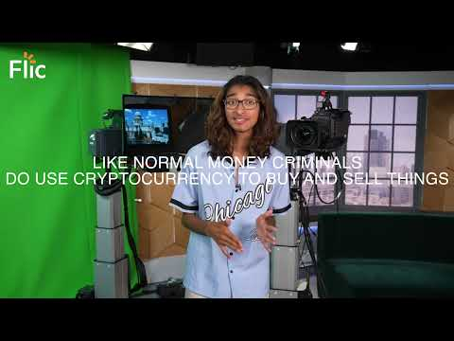
Myths about cryptocurrency
5 myths about cryptocurrency:

Slide 22
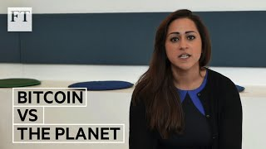
Ethical considerations
Environmental
Cryptocurrencies can be environmentally unfriendly because it takes a large amount of energy to power the technology they require. Bitcoin alone uses more energy than some entire countries!
There are increasing efforts to try to make cryptocurrencies greener.
Social Some people get short time happiness from their cryptocurrencies going up and down, but others can end up suffering from severe anxiety.
Some people have ended up treating it like gambling or committing crimes to fund it.
Read about different peoples’ experiences with crypto in this article (The Guardian, 2022)
Watch the video
https://www.ft.com/video/ce61990f-ba96-4759-8979-139dd6ccd8d9
Notes:
Further example
That is what happened to a man called Jake, who told the BBC that he had lost millions after becoming addicted to trading cryptocurrencies. Jake did not have millions to lose — he was charged with stealing £1.5mn from his employer.

Slide 23
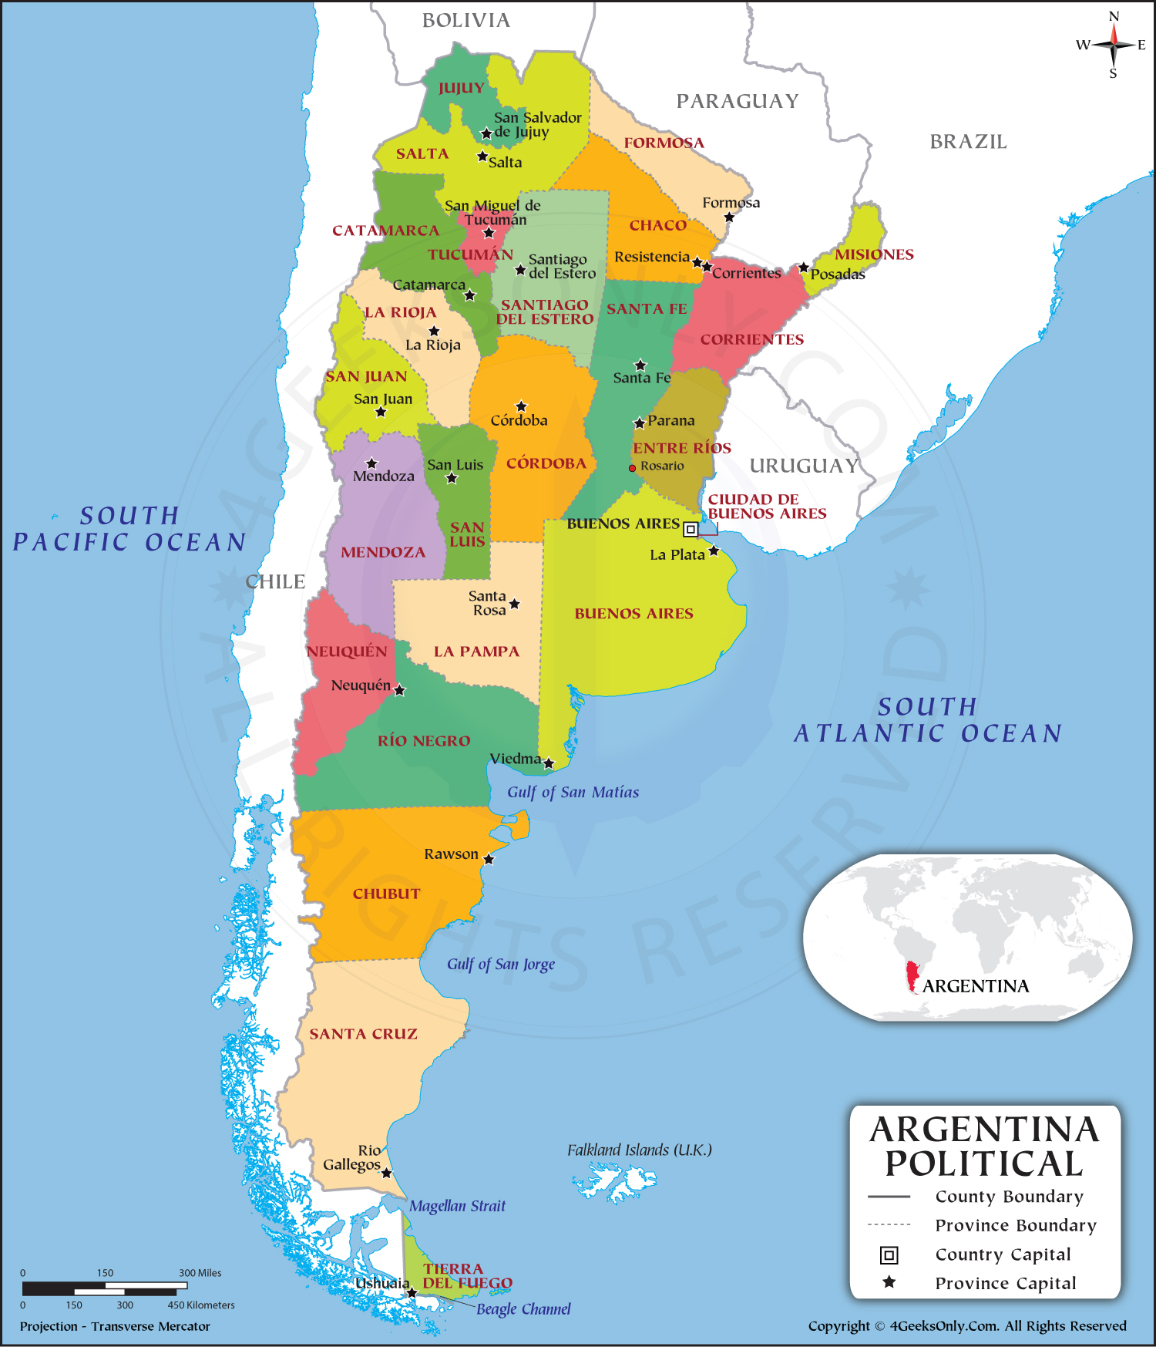
Did you know?
Mining Bitcoin uses more energy than the whole of Argentina!
Notes:
https://www.bbc.co.uk/news/technology-56012952

Slide 24
Multiple choice
1. Who can own a cryptocurrency?
A | B | C
Anyone | People over the age of 16 | People that have been financially trained

Slide 25
Multiple choice
1. Who can own a cryptocurrency?
A | B | C
Anyone | People over the age of 16 | People that have been financially trained
Note that this is different to opening an account or trading.
Most cryptocurrency exchanges require customer to be 18 or older.

Slide 26
Multiple choice
2. Which of these sets of words accurately define Bitcoin?
A | B | C
High-risk and stable | Low-risk and volatile | High-risk and volatile

Slide 27
Multiple choice
2. Which of these sets of words accurately define Bitcoin?
A | B | C
High-risk and stable | Low-risk and volatile | High-risk and volatile

Slide 28
Multiple choice
3. The supply of bitcoin is…
A | B | C
Changeable because more can be created or issued | Carefully controlled and limited | Controlled by governments or banks

Slide 29
Multiple choice
3. The supply of bitcoin is…
A | B | C
Changeable because more can be created or issued | Carefully controlled and limited | Controlled by governments or banks

Slide 30
Multiple choice
4. Which of these statements is FALSE about blockchain?
A | B | C
Blockchain technology is used for the purposes of cryptocurrencies only | Blockchain technology is a decentralised system | Records on the blockchain cannot be changed and are secured using something called ‘cryptography

Slide 31
Multiple choice
4. Which of these statements is FALSE about blockchain?
A | B | C
Blockchain technology is used for the purposes of cryptocurrencies only | Blockchain technology is a decentralised system | Records on the blockchain cannot be changed and are secured using something called ‘cryptography

Slide 32
Multiple choice
5. Which of these statements is TRUE?
A | B | C
Cryptocurrencies will always make a person rich quickly | Cryptocurrencies are mostly used by thieves | There’s never a guarantee that any cryptocurrency or other investment will make someone money

Slide 33
Multiple choice
5. Which of these statements is TRUE?
A | B | C
Cryptocurrencies will always make a person rich quickly | Cryptocurrencies are mostly used by thieves | There’s never a guarantee that any cryptocurrency or other investment will make someone money

Slide 34
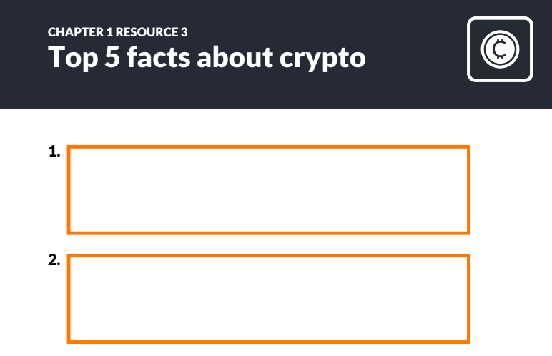
What is cryptocurrency?
Design a Top 5 Facts sheet
about cryptocurrency.
Hand it in to your teacher as an exit card when you leave the room.
Insert image of resource
Resource 3: Fact Sheet Template (Optional Use)

Slide 35
Cash or crypto?
How can cryptocurrency make a person feel?
Anxious
Excited
Disappointed
Powerful
Frustrated
Relevant
Notes:
Teacher explanation
It may be that young people might think about crypto as ‘empowering’ ‘revolutionary’ or ‘exciting’ – if this is the case, explain reasons why, although these might be feelings associated with investing in crypto, there is also a lot of anxiety, disappointment, confusion and frustration that can also be generated.

Slide 36
Any questions?
?

Slide 37
‘I will learn how cryptocurrency assets work and how to assess the risks and opportunities that they present’
By the end of the session, I will be able to:
Define what cryptocurrency is and describe how it compares with traditional money
Recognise the influence of social media and peers on financial decisions
Confidently identify the risks that cryptocurrencies present
Explain the warning signs of cryptocurrency scams and what to do when they are spotted
Notes:
Teacher asks students to rate level of confidence from 1-10 on their fingers, so they can target students with support/extension appropriately.

Slide 38
BREAK
Design your own coin
Resource 4: Design Sheet Template

Slide 39
Chapter 2:
Factors influencing our financial decisions
Who does cryptocurrency appeal to?

Slide 40
Would you recommend that a friend buys cryptocurrency?
Rate your answer out of 10 (1 being very unlikely to recommend and 10 being very likely to recommend).
Write your answer in your book, explaining why.
Notes:
Delivery instruction
Teacher to circulate and invite feedback; or all students can show their responses on their hands.

Slide 41
Who does cryptocurrency appeal to?
What is the message being given in this bitcoin advert?
This activity is suggested for Years 11,12 and 13
Please note the information in the video applies to the US, not UK
Notes:
https://news.bitcoin.com/spike-lee-directs-commercial-cryptocurrency-atms/

Slide 42
Who does cryptocurrency appeal to?
Which audiences does crypto appeal to?
Why do we think crypto might appeal to these groups of people?
What are the potential problems or risks with this advert?
This activity is suggested for Years 11, 12 and 13
Notes:
https://news.bitcoin.com/spike-lee-directs-commercial-cryptocurrency-atms/

Slide 43
Who does cryptocurrency appeal to?
Which audiences do crypto appeal to?
Often vulnerable groups of people like ethnic minorities or women.
Why do we think crypto might appeal to these groups of people?
Because it looks like an alternative to traditional money and banks, so people may think that it promotes financial inclusion.
What are the potential problems or risks with this advert?
Crypto is not a good solution as it is unregulated so people can lose a lot of money and be involved in scams and not get their money back.
Notes:
https://news.bitcoin.com/spike-lee-directs-commercial-cryptocurrency-atms/

Slide 44
Who does cryptocurrency appeal to?
What are the factors that would influence this person’s decision to use cryptocurrency?
This is Zak.
Zak is 20 years old and is about to complete his last year at university studying software design. He will be living with his dad, who is a carer for his mum. He will not be able to leave home as he has not saved enough money for his own place. Zak is really interested in cryptocurrency, especially since some of his favourite bands have recently invested. It is all his friends at university talk about.

Slide 45
Who does cryptocurrency appeal to?
How might the highlighted factors influence Zak’s decision to use cryptocurrency?
This is Zak.
Zak is 20 years old and is about to complete his last year at university studying software design. He will be living with his dad, who is a carer for his mum. He will not be able to leave home as he has not saved enough money for his own place. Zak is really interested in cryptocurrency, especially since some of his favourite bands have recently invested. It is all his friends at university talk about.

Slide 46
Who does cryptocurrency appeal to?
Lots of factors will determine who might engage with cryptocurrency.
Some personal circumstances lead to people having a more positive relationship with money. They then may invest in things such as cryptocurrency which could improve their standard of living.
However, some influencing factors such as information from friends and the media could encourage a lot of risk-taking behaviour.

Slide 47
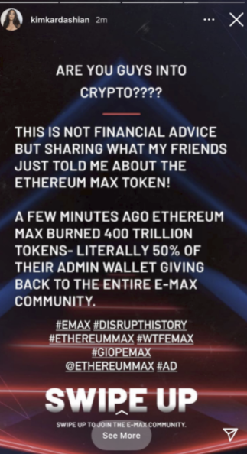
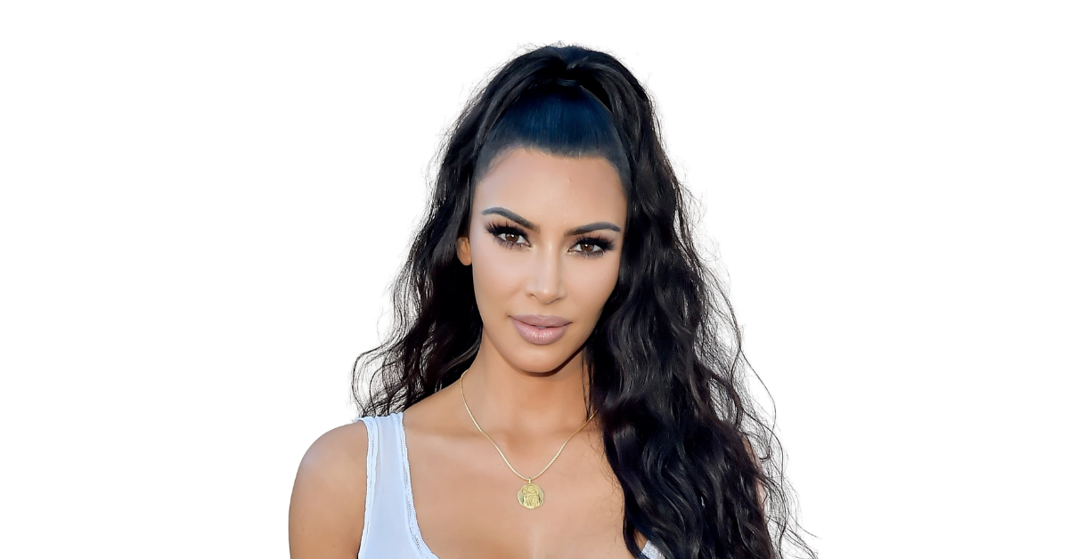
How does social media impact decision making?
What do you think happened next?
What do you think consumers did?
What do you think happened to the value of the coin?
Notes:
Teacher prompt questions
Why did the value of the coin decrease?
Why is that a bad thing?
Who would have been able to benefit in this scenario?
How might someone protect themselves or make the best out of this situation?

Slide 48
How does social media impact decision-making?
Influencers promote everything from fashion to sport and also cryptocurrencies.
Companies pay them to do this because seeing someone popular endorse a product can be really encouraging. But influencers are not always right!
Reality star Kim Kardashian and boxer Floyd Mayweather promoted the Ethereum Max coin to their followers last year. But then, the value of the coin fell sharply. If you had put $100 into the coins when those ads ran in May 2021, it would have been worth just $3
by the end of the year.
The celebrities, along with the executives from EthereumMax, hit the headlines
when investors sued, accusing them of allegedly making “false and misleading”
statements to their fans.
Notes:
https://www.theguardian.com/technology/2022/jan/13/investors-sue-kim-kardashian-and-floyd-mayweather-jr-over-crypto-scheme-ethereummax

Slide 49
What happened next?
Kim Kardashian had to pay a $1.26 million fine for promotion of the token without disclosing that she was paid for the promotion.
The value of the company’s EthereumMax tokens increased by as much as 1,370% after the social media posts before crashing to an all-time low.
Notes:
https://www.theguardian.com/technology/2022/jan/13/investors-sue-kim-kardashian-and-floyd-mayweather-jr-over-crypto-scheme-ethereummax

Slide 50
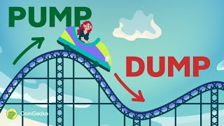
Other red flags! ‘Pump and dump’
Unknown coins rising rapidly in value
Paid ads
Lots of social media activity
Play until 1:00
https://www.youtube.com/watch?v=CakdQBB5QnQ
Notes:
Alternative video: https://www.youtube.com/watch?v=YJVtgv6Zmq4

Slide 51
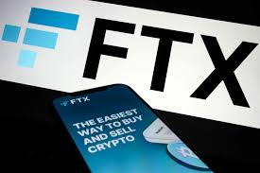
FTX case study
Explanation
People talk about cryptocurrencies but there also places where people hold their coins and exchange their coins called exchanges.
FTX is an example of an exchange which went bankrupt. Lots of well known investors had put money into FTX and over a million people had deposited money at the exchange. Famous people like supermodels and sports stars had also advertised FTX. Lots of people lost a lot of money when it went bankrupt.
The main reason this happened is because crypto exchanges and crypto organisations are currently unregulated. This means customers and investors don’t have the same protections as putting money in a regular bank.
Read the quote below.
What do you think happened?
How might this person feel?
“I and many others - we got caught up in a kind of intense euphoria last year, about the small guy’s chance of going from zero to hero, and this is now the morning after. The hardest thing about this loss is - we didn’t get the chance to lose the money ourselves, it was just taken from us.”
Source found here.
Notes:
https://www.theguardian.com/technology/2022/nov/19/the-money-is-gone-people-who-lost-out-in-ftxs-collapse

Slide 52
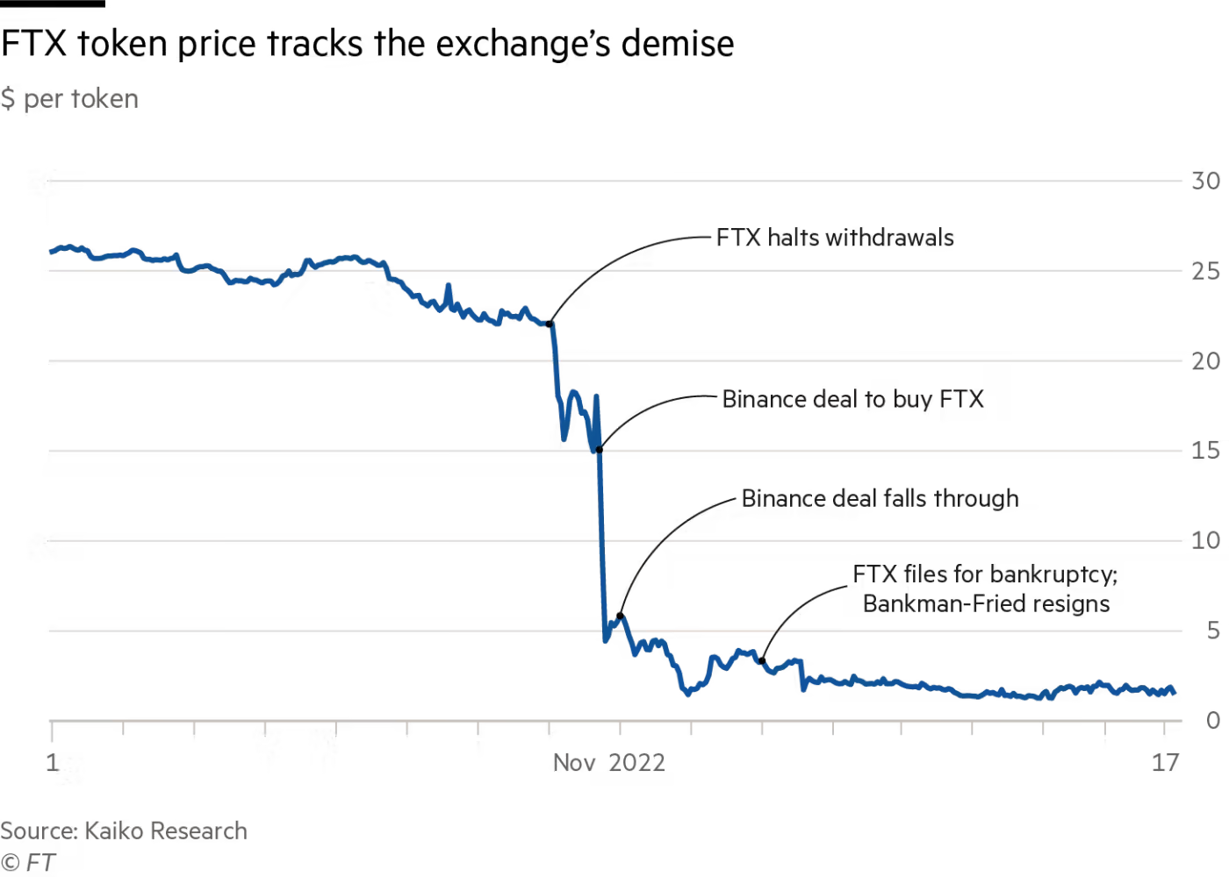
FTX case study
This graph shows how quickly the value of the FTX crypto exchange’s crypto coin, FTT, collapsed when people were worried that FTX was not being run properly.

Slide 53
Crypto timeline | Can you order the five events below?
Stretch - estimate the year the events took place
2010
2023
Crypto ‘winter’
The prices of popular cryptocurrencies like bitcoin and ethereum collapsed from what was (at the time) all time highs. The period is infamous in crypto history for causing widespread financial losses for early crypto investors.
Crypto ‘winter’ revisited
A year later the crypto market crashed again, causing an unprecedented amount of financial loss for investors and causing multiple high profile companies (including FTX) to collapse and go bankrupt. Prices have not recovered to 2021 highs and regulators around the world have responded by cracking down on crypto like never before.
Crypto bull run
The crypto industry enjoyed mainstream attention like never before when many big-name companies and investors bought into digital assets. Prices of popular tokens sky-rocketed, including bitcoin which nearly reached $70,000. Companies like Coinbase and (now bankrupt) FTX advertised during the Super Bowl in a watershed moment for the industry.
Silk Road
Was an online darknet marketplace used to trade in illicit goods. Users were able to buy and sell anonymously using cryptocurrency. The platform was eventually shut down by authorities and its founder, Ross Ulbricht, was sentenced to life in prison.
Mt. Gox collapse
Mt. Gox was - at its height - the world’s largest bitcoin exchange, processing roughly 70% of all bitcoin transactions. It was hacked and compromised, causing the price of bitcoin to plummet.

Slide 54
Crypto timeline
ANSWERS
2010
2023
2011
Silk Road (2011)
Was an online darknet marketplace used to trade in illicit goods. Users were able to buy and sell anonymously using cryptocurrency. The platform was eventually shut down by authorities and its founder, Ross Ulbricht, was sentenced to life in prison.
2014
Mt. Gox collapse
Mt. Gox was - at its height - the world’s largest bitcoin exchange, processing roughly 70% of all bitcoin transactions. It was hacked and compromised, causing the price of bitcoin to plummet.
2018
Crypto ‘winter’
The prices of popular cryptocurrencies like bitcoin and ethereum collapsed from what was (at the time) all time highs. The period is infamous in crypto history for causing widespread financial losses for early crypto investors.
2021
Crypto bull run
The crypto industry enjoyed mainstream attention like never before when many big-name companies and investors bought into digital assets. Prices of popular tokens sky-rocketed, including bitcoin which nearly reached $70,000. Companies like Coinbase and (now bankrupt) FTX advertised during the Super Bowl in a watershed moment for the industry.
2022
Crypto ‘winter’ revisited
A year later the crypto market crashed again, causing an unprecedented amount of financial loss for investors and causing multiple high profile companies (including FTX) to collapse and go bankrupt. Prices have not recovered to 2021 highs and regulators around the world have responded by cracking down on crypto like never before.

Slide 55
How to manage influences
You receive this message from a friend:
“Hey! Have you seen the price of Kattacoin?!
It’s 15% cheaper than it has been.
You should buy. I have!!!”
Use the worksheet to create a conversation in response to the message
Resource 5: Text conversation template

Slide 56
Any questions?
?

Slide 57
‘I will learn how cryptocurrency assets work and how to assess the risks and opportunities that they present’
By the end of the session, I will be able to:
Describe what cryptocurrency is and how it compares with traditional money
Recognise the influence of social media and peers on financial decisions
Confidently identify the risks that cryptocurrencies present
Explain the warning signs of cryptocurrency scams and what to do when they are spotted

Slide 58
BREAK

Slide 59
Chapter 3:
Research and making informed decisions
Would you recommend that a friend buys cryptocurrency?

Slide 60
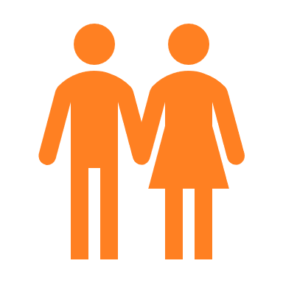
What does good research involve?
Think
Pair
Share

Slide 61
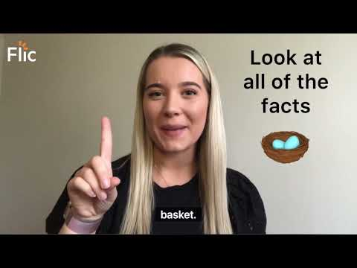
What does good research involve?
Too good to be true?
https://youtu.be/3xVMpSI1GfE

Slide 62
Did you know?
A crypto company’s registration number can be checked on Companies House to check whether it is a legitimate company (applies to UK firms only).
Most cryptocurrencies are not regulated by the FCA (Financial Conduct Authority), even if the firm providing the crypto is. This means people aren’t protected by the UK’s Financial Compensation Scheme.
If someone is scammed, they are unlikely to get their money back.

Slide 63
Being aware
What are the fees?
Buying and selling cryptocurrencies can be expensive and fees can eat up any of the profits that might be earned through rising values.
What are buyout terms?
Cryptocurrency is up 20% in one day, investors are delighted and want to get their money out. Then they find out they can’t.
Sometimes it is because the site they traded on has crashed or gone offline. Everyone had the same idea, they all tried to log on at the same time and now there is a complete outage.
Sometimes it is because they cannot trade instantly. The terms they signed up to might mean that they can place an order, but the site does not have to act on it instantly.
Notes:
Fees
Buying and selling cryptocurrencies can be expensive, and fees can eat up a lot of the profits you might earn through rising prices.
The fees can be hard to understand, and they can vary a lot, but they are often higher than people expect and higher than other investments.
Buyout terms - You might get stuck
Picture this: Your crypto currency is up 20pc in one day, you’re delighted and want to get your money out. Then you find out you can’t.
Sometimes it’s because the site you trade on has gone down. Everyone had the same idea, they all tried to log on at the same time, and bang, you’ve got a complete outage.
Sometimes it’s because you can’t trade instantly, the terms of what you signed up to means that you can place an order, but the site doesn’t have to act on it instantly.
It can go the opposite way too. In May 2021, when crypto markets crashed and lots of people were trying to get their money out, one crypto exchange Binance went down across the world. People who were trying to trade on Binance, and were hurt by the outage, have raised $5m to sue the exchange but there’s no guarantee they’ll get back what they lost.
Your cryptocurrency might die
Some crypto currencies completely disappear. They become known as Dead Coins.
There are already more than 2,000 Dead Coins.
If you put money into a coin, and it dies, you’re probably not going to see your money again.
Your crypto might fall sharply in value
There’s a lot of uncertainty about the value of the cryptocurrencies that are still out there, even the biggest one, Bitcoin.
Jamie Dimon, who runs the world’s biggest bank, describes the whole thing as a “fraud” and says it’s going to turn out worse than the tulip bulbs bubble in Holland in the early 1600s.
See video on Tulipmania… https://www.youtube.com/watch?v=bq1fbB9_rLs
One potential future threat comes from regulation. China launched a big clampdown on crypto last year, which hit prices very hard when it was announced. If other countries introduced new rules around cryptocurrencies, they could become less valuable, especially because some argue that the value of crypto now actually comes from the fact there are no rules, so it’s popular with people trying to dodge the law.

Slide 64
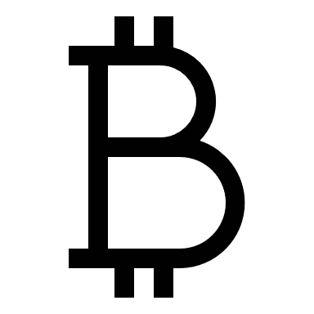
Weighing up bitcoin
We are going to use bitcoin as an example of a cryptocurrency to research.
We’ll apply our learning on the topic so far to assess:
What factors make bitcoin an appealing choice to some people
The main cryptocurrency red flags to look out for

Slide 65
Should a person ever ‘invest’ in bitcoin?
How useful is this information?
Bitcoin was the first major usable cryptocurrency. It has the highest market cap and its coins trade at the highest cost of all cryptocurrencies. Because it was the first, bitcoin is the reason anyone is talking about cryptocurrency in the first place.
Despite the big increase in price, bitcoin is the most familiar and invested-in coin, often for those trying out cryptocurrencies for the first time.
Many celebrities have talked about investing in bitcoin, including 50 Cent, Bill Gates, Serena Williams, Floyd Mayweather and Mike Tyson.
But these celebrities are all very rich and can afford to lose money….
Could it ever be safe for someone to buy bitcoin?
Notes:
Market cap means the total value of all the coins that have been mined.

Slide 66
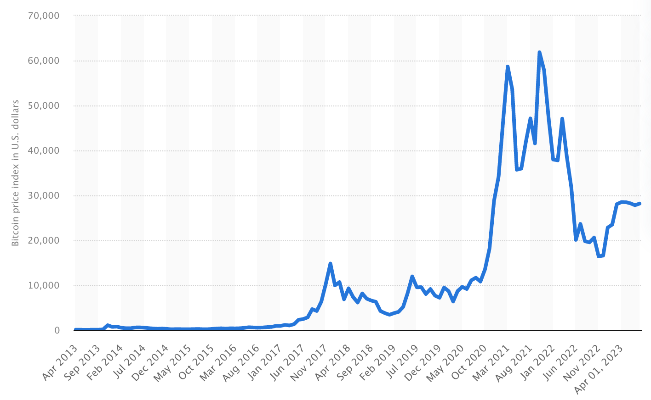
How has the value of bitcoin changed?
Crypto: higher or lower?
Jan 2009
£0
<£0.01
£950
£240
£15,000
May 2010
Dec 2013
Jan 2015
Dec 2017
Stretch | Can you work out the percentage increase or decrease?
£4,500
£22,000
£60,000
£14,000
Dec 2019
Dec 2020
Nov 2021
Dec 2022
*Note that the numbers shown have been rounded, so are approximate.
Notes:
Teacher explanation
The value of Bitcoin has gone up and down over the years since it was created in 2009 and some people don't think it's safe to turn 'real' money into Bitcoins.
This concern was expressed by the head of The Bank of England, Andrew Bailey, in October 2020.
He said that he was "very nervous" about people using Bitcoin for payments pointing out that investors should realise its price is extremely volatile.
By this, he meant that the value could drop significantly at any moment and investors could lose a lot of money.

Slide 67
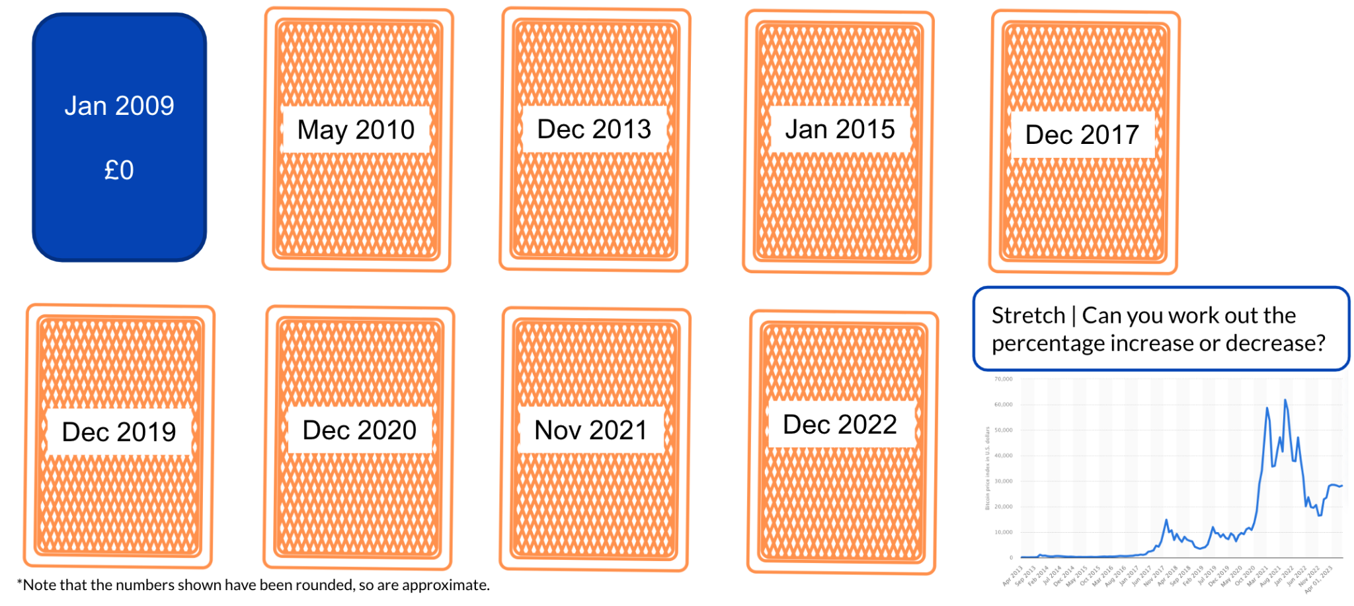
How has the value of bitcoin changed?
Crypto: higher or lower?
How did playing the game make you feel?
What did it feel like when the value went up?
What did it feel like when the value went down?

Slide 68
Making informed decisions
Your friend is considering buying bitcoin. Your job is to send them 4-6 bullet points of information to help them make a decision, answering the following questions.
What makes bitcoin an appealing choice?
What are bitcoin’s “red flags” and what are the risks of buying bitcoin?
Is putting money into bitcoin more of an investment or a gamble?
Read this FT article (May 2023) for more information.

Slide 69
Meet the savvy investor
A savvy investor:
Puts money into things that they believe have value
Does their research with reliable sources
Invests for the long term, not trying to make short term gains
Diversifies (varies) their investments
Savvy investor!
Notes:
https://twitter.com/thefca/status/1642832976600809474?s=46

Slide 70
Any questions?
?

Slide 71
Over to you (hand to your teacher as you leave)…
What are the 3 most important things you have learnt about cryptocurrency?
What’s one key question you still have about cryptocurrency?

Slide 72
‘I will learn how cryptocurrency assets work and how to assess the risks and opportunities that they present’
By the end of the session, I will be able to:
Describe what cryptocurrency is and how it compares with traditional money
Recognise the influence of social media and peers on my financial decisions
Confidently identify the risks that cryptocurrencies present
Explain the warning signs of cryptocurrency scams and what to do when they are spotted

Slide 73
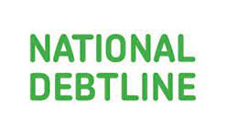
Services available for people who have concerns about their personal finances
Citizens Advice – Debt and Money – This resource contains links to advice on a number of topics, including financial difficulties, cost of living and communicating with creditors.
National Debtline – Debt and Money – a debt advice charity run by the Money Advice Trust, offering a free and confidential debt advice service.
NSPCC Helpline 0808 800 5000
Childline Helpline 0800 1111
At school, you can speak with an adult you trust.
This could be your form tutor, head of year or the school’s safeguarding officer.

Slide 74
Links to learn more!
RESOURCES TO EXTEND LEARNING
The Financial Conduct Authority | Crypto: The basics
FTX: the legend of Sam Bankman-Fried | FT Film
Blockchain a clickable guide
Going for Broke in Cryptoland
What you should know about pump and dump
What are digital assets?
Tech Tonic Season 4 podcast: A Sceptic’s Guide to Crypto
Please visit the FLIC learning hub - https://ftflic.com/learning-hub/ for further resources

