Slide 1
How to look after your money
This session is aimed at key stage three, four or five (recommended for Year 9 and above)

Slide 2
Contents
Chapter 1 Money mindsets and budgeting in practice
Chapter 2 Money mindsets and budgeting in practice
Chapter 3
Understanding payslips
Chapter 4 Inflation, what does it means for budgeting?

Slide 3
What is FLIC?
The Financial Times news group has set up a charity (Financial Literacy and Inclusion Campaign) focused on building up the financial knowledge and skills of everyone in the UK, especially the people that don’t usually come across this information.

Slide 4
By the end of the session, I will be able to:
Describe the difference between financial needs and wants and the external influences that could impact them.
Determine smart choices about managing my money that align with needs, wants and future goals.
Identify different budgeting systems and how to apply them in different contexts.
Examine how income from jobs is taxed and calculate how much is left to budget.
Recognise inflation and understand how it is measured.
Explain how the value of money can change over time and how that impacts budgeting.

Slide 5
Having a respectful learning environment
We will listen to each other respectfully
We will avoid making judgements or assumptions about others
We will comment on what has been said, not the person who has said it
We won’t put anyone on the spot and we have the right to pass
We will not share personal stories or ask personal questions

Slide 6
Chapter 1:
Money mindsets

Slide 7
Asking BIG money questions
“Why is it important to think about how we use our money?”
Your question here
“What does it mean to be good at managing money?”
“How can money make people feel?”
If there is a question that you do not wish to ask aloud, you can write it on a post-it note which will be collected throughout the session and answered at the end

Slide 8
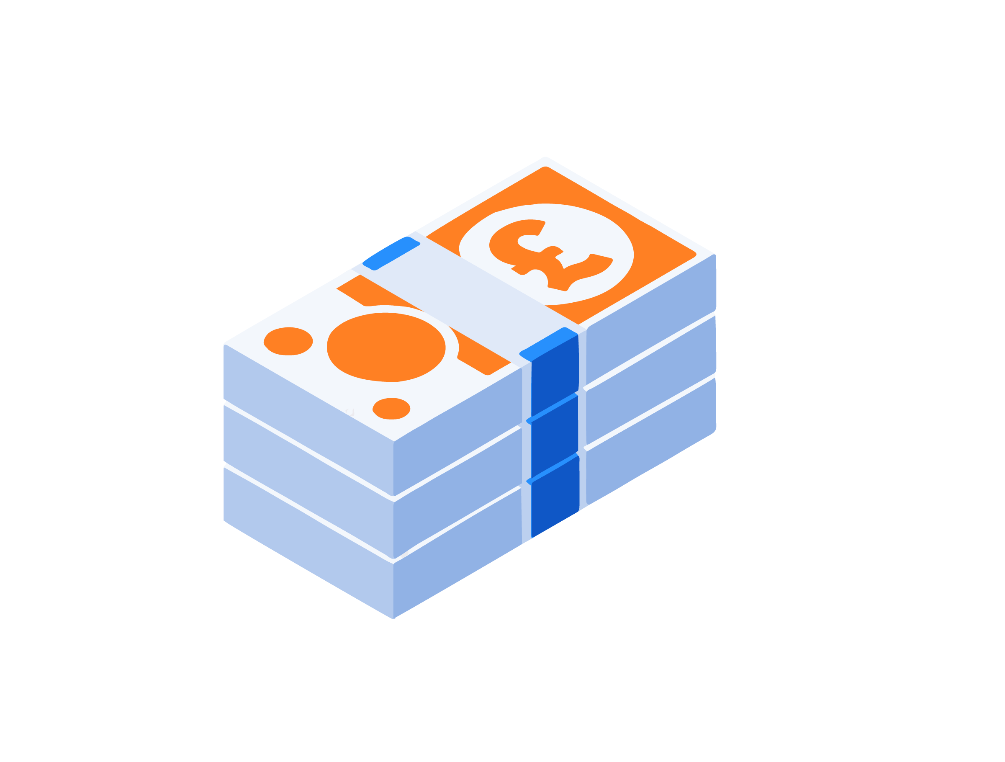
Money mindsets
Agree Disagree
1. Money is easy to come by
2. Money is there to be spent
3. People should always be aware of how much money is in
their bank account
4. People should distinguish between essential and non-essential spending
5. People should always save some of the money they earn

Slide 9
Needs vs Wants
Thinking about what money is spent on can help a person to budget.
The key question to ask when budgeting is
‘Do I need it or do I want it’? Can it be both?
Food &
Takeaways
Shoes
AirPods

Slide 10
Poku Banks
Learning recap: Needs vs Wants
https://www.youtube.com/watch?v=IP9DFYapa8o
How can you tell what is NEEDED to buy from what is WANTED to buy?
If it is difficult to decipher what is a need or want, ask the three questions in this video.

Slide 11
Discussion
How might a person’s needs change over time?

Slide 12
Conscious spending
Not FOMO

Slide 13
By the end of the session, I will be able to:
Describe the difference between financial needs and wants and the external influences that could impact them.
Determine smart choices about managing my money that align with needs, wants and future goals.
Identify different budgeting systems and how to apply them in different contexts.
Examine how income from jobs is taxed and calculate how much is left to budget.
Recognise inflation and understand how it is measured.
Explain how the value of money can change over time and how that impacts budgeting.

Slide 14
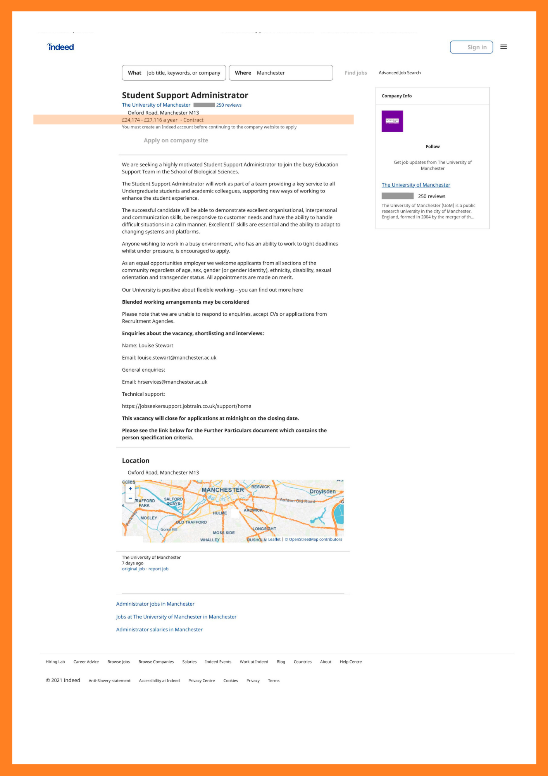
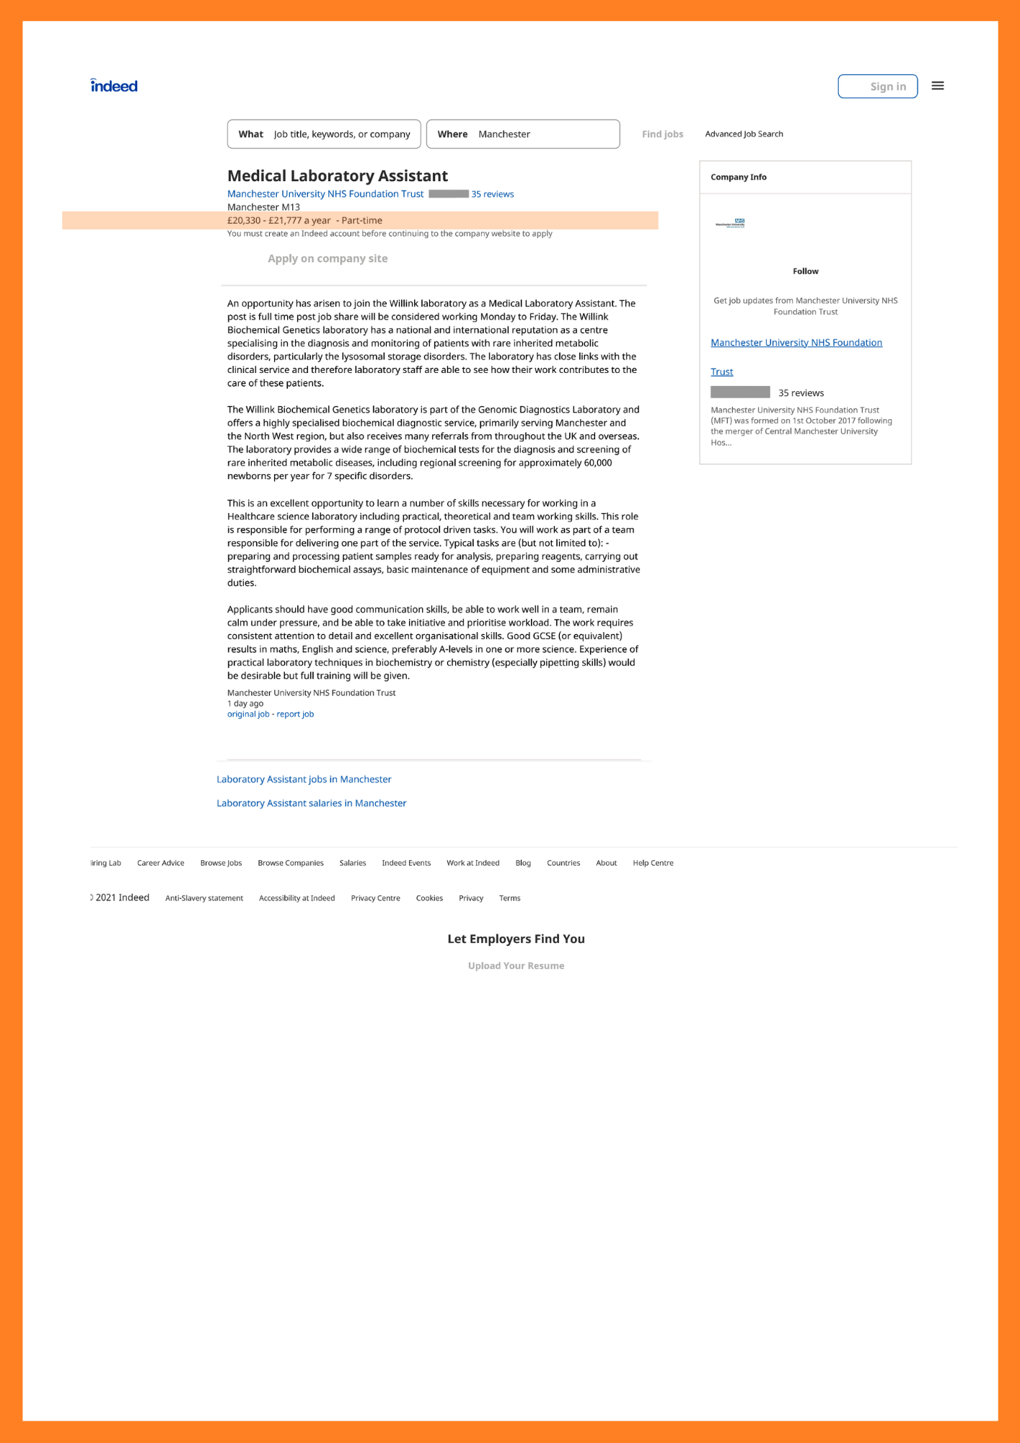
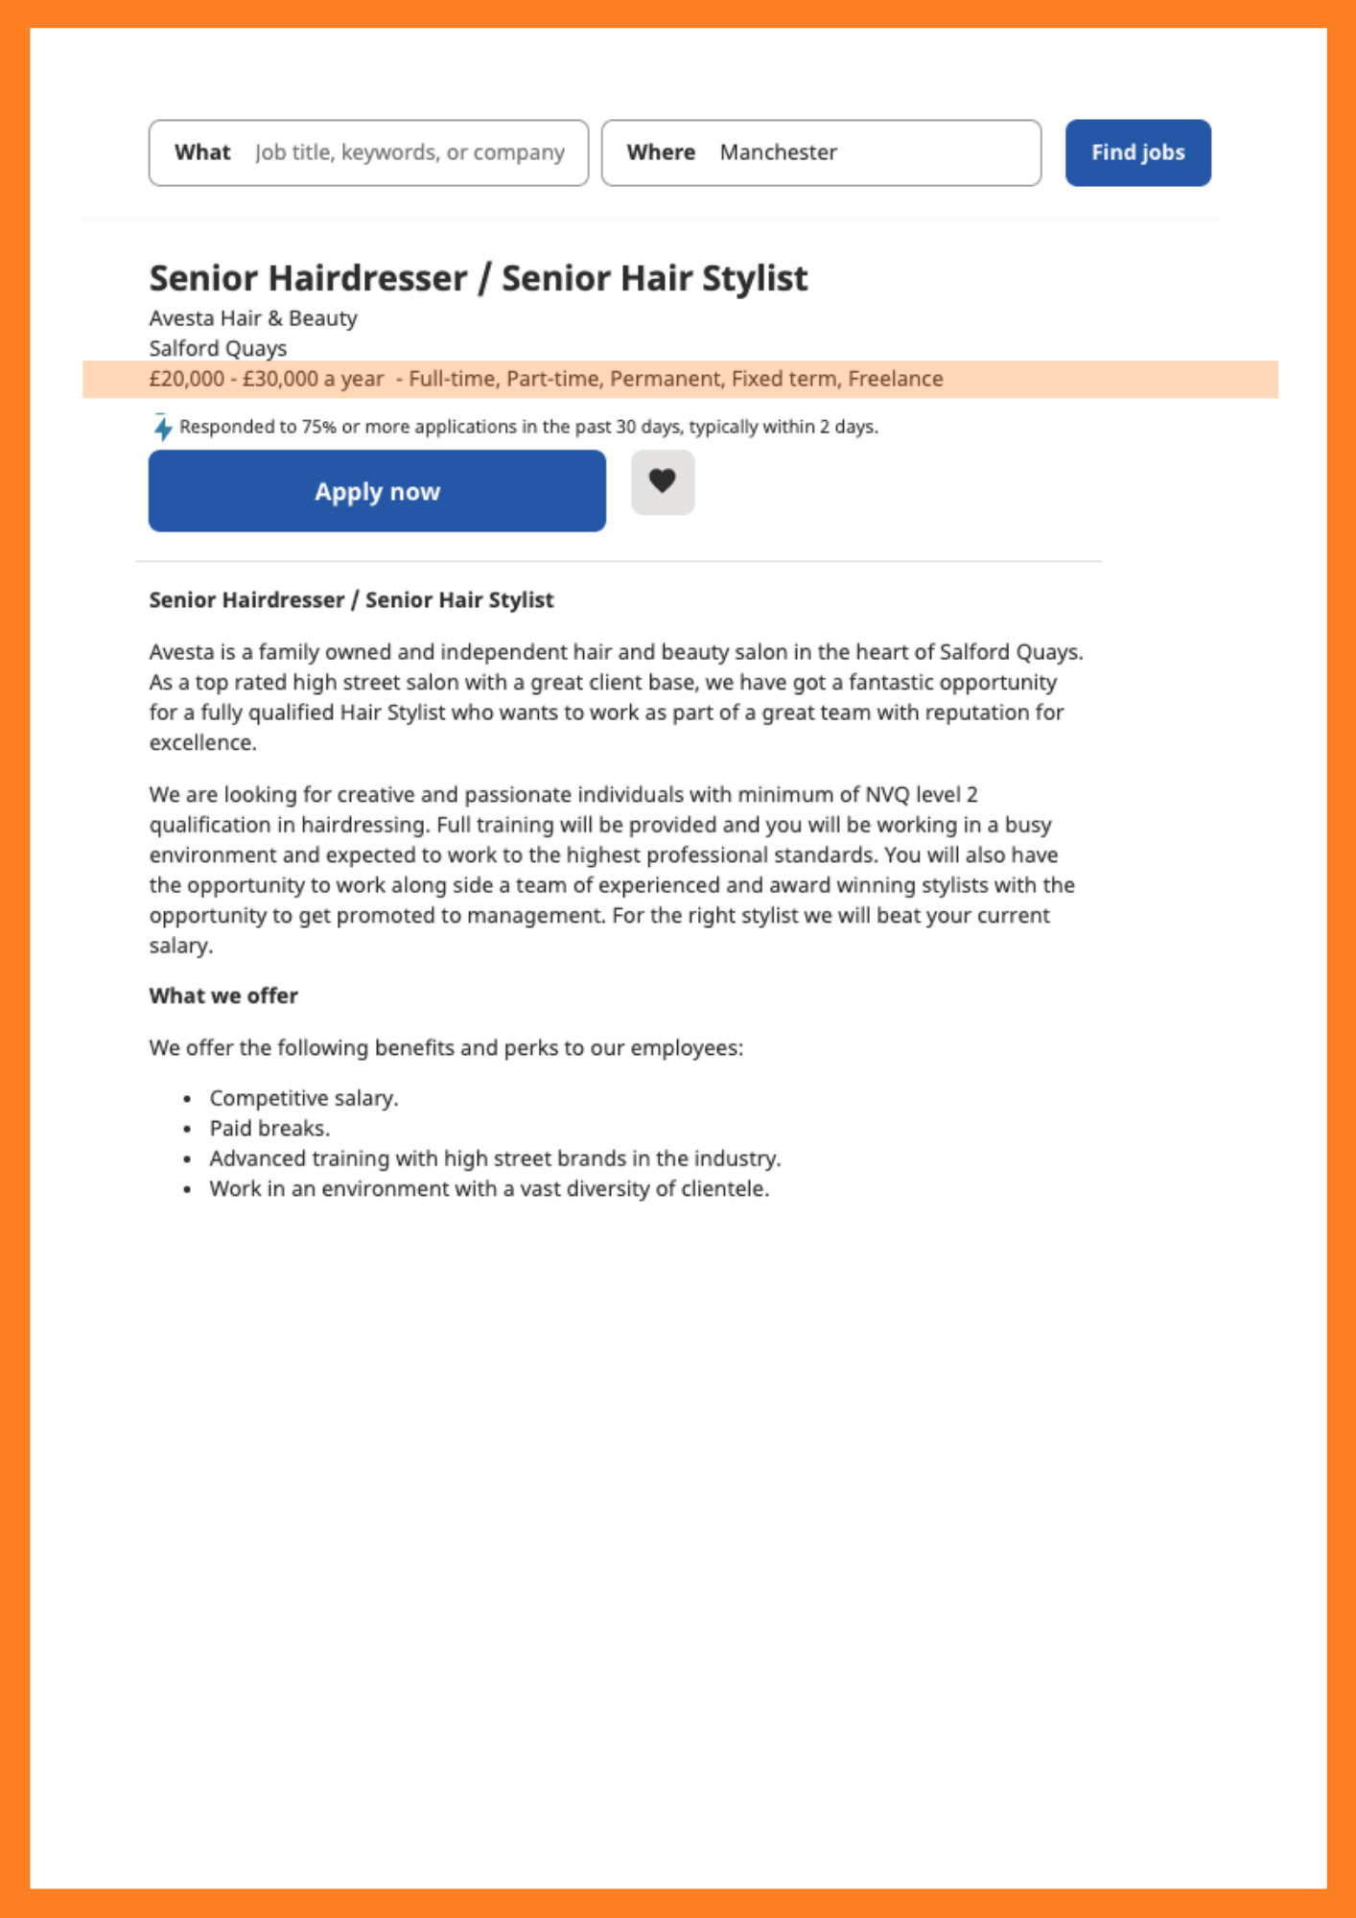
You need a job!
Whether it’s needs or wants, we need a job to earn money.
Read through the job description that you have been given and consider the following
questions:
What are the hours needed to work?
Is the job full time or part time?
What qualifications or experience is needed?
What other skills are important?
What is the salary?
Stretch: Will this salary cover the costs of needs and wants?

Slide 15
You need a job!
Which job did you choose?

Slide 16
Your future
Write a paragraph summarising what you have learnt today.
You may use the sentence starters for support.
Some of the things that I will need when I am older are…
When I am older, I also want…
This means I need to have an income.
From my research today, I could consider a job as a…
The job would be good for me because…
Other jobs that I would like to research are..
When researching three things I will consider…

Slide 17
By the end of the session, I will be able to:
Describe the difference between financial needs and wants and the external influences that could impact them.
Determine smart choices about managing my money that align with needs, wants and future goals.
Identify different budgeting systems and how to apply them in different contexts.
Examine how income from jobs is taxed and calculate how much is left to budget.
Recognise inflation and understand how it is measured.
Explain how the value of money can change over time and how that impacts budgeting.

Slide 18
Any questions?
?

Slide 19
Chapter 2:
Money mindsets and budgeting in practice

Slide 20
By the end of the session, I will be able to:
Describe the difference between financial needs and wants and the external influences that could impact them.
Determine smart choices about managing my money that align with needs, wants and future goals.
Identify different budgeting systems and how to apply them in different contexts.
Examine how income from jobs is taxed and calculate how much is left to budget.
Recognise inflation and understand how it is measured.
Explain how the value of money can change over time and how that impacts budgeting.

Slide 21
Having a respectful learning environment
We will listen to each other respectfully
We will avoid making judgements or assumptions about others
We will comment on what has been said, not the person who has said it
We won’t put anyone on the spot and we have the right to pass
We will not share personal stories or ask personal questions

Slide 22
Needs vs Wants
Create two lists - one for needs and one for wants
Food &
Takeaways
Shoes
Rent
AirPods

Slide 23
Budgeting
what is a budget?
how do people budget?
how would you split your wages?

Slide 24
Keeping it old school!
Needs
20%
Wants
Future (savings, investments and rainy day fund)
50%
30%

Slide 25
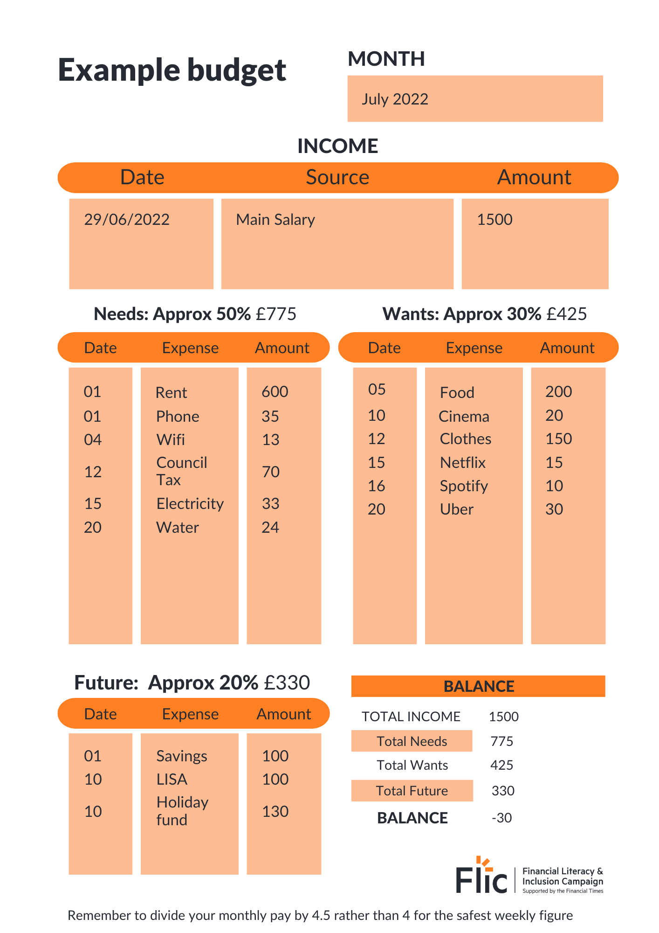
Calculating your needs
What do people NEED to spend their money on?
Task!
Read through the bills catalogue
Budget for needs. Choose somewhere to live, the utilities, taxes, transport, TV, internet and food. Add the cost of each of these to the worksheet.
Remember the needs should account for roughly 50% of your income!

Slide 26
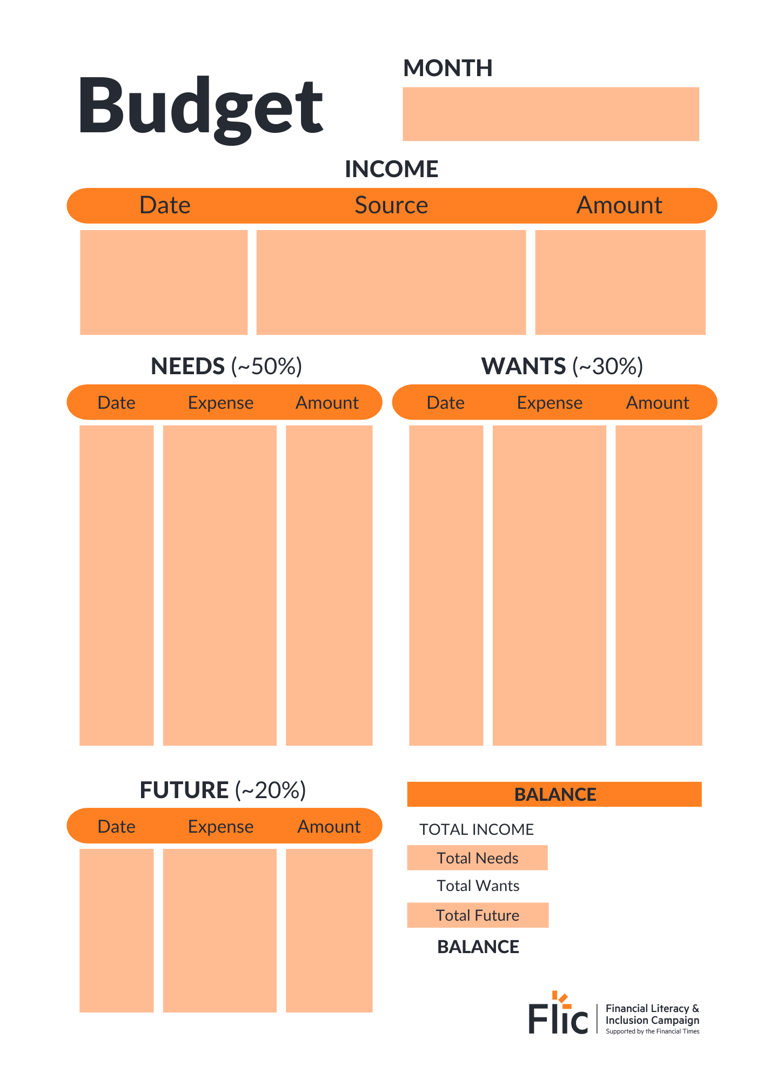
Calculating your wants
What do people WANT to spend their money on?
Task!
Read through the bills catalogue
Budget for wants. Look at the ‘other potential costs’. Are these needs or wants? Are there any others that could be added to the sheet?
Can you think of top tips to help slow down when it comes to wants?
Remember, wants should account for roughly 30% of a person’s income!

Slide 27
Calculating your budget
What are some of the issues people might face when budgeting?
Were there any items that were switched from a need to a want?

Slide 28
Planning your future
Savings
Investments
Unplanned for events

Slide 29
Digital budgeting tools
How might apps be able to help people with budgeting?
Click here to watch a video explaining how digital budgeting tools can be used: https://youtu.be/rc7sgvOj6q8

Slide 30
Planning your future

Slide 31
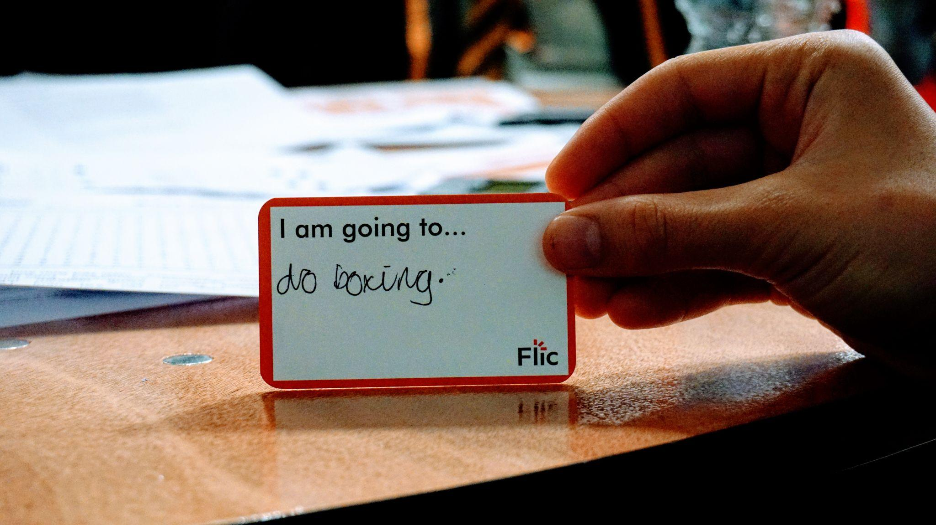
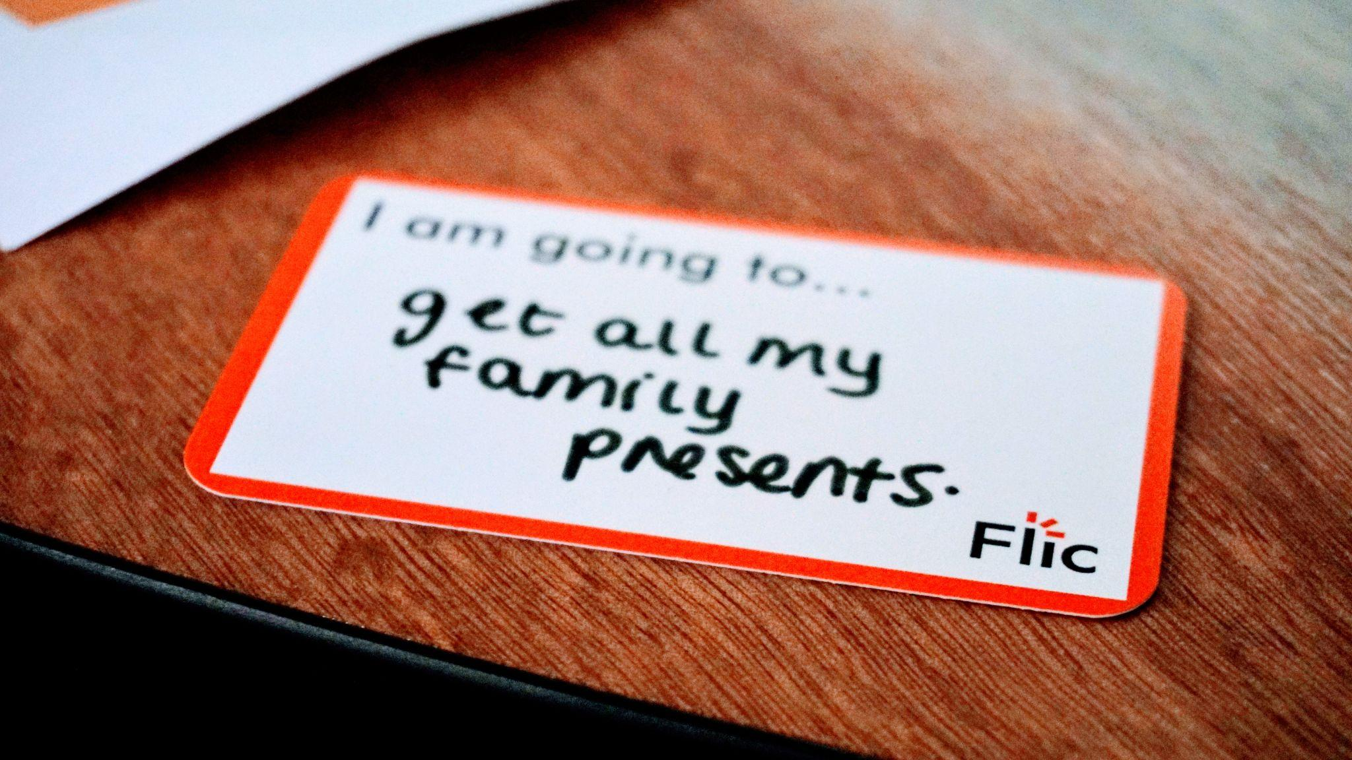
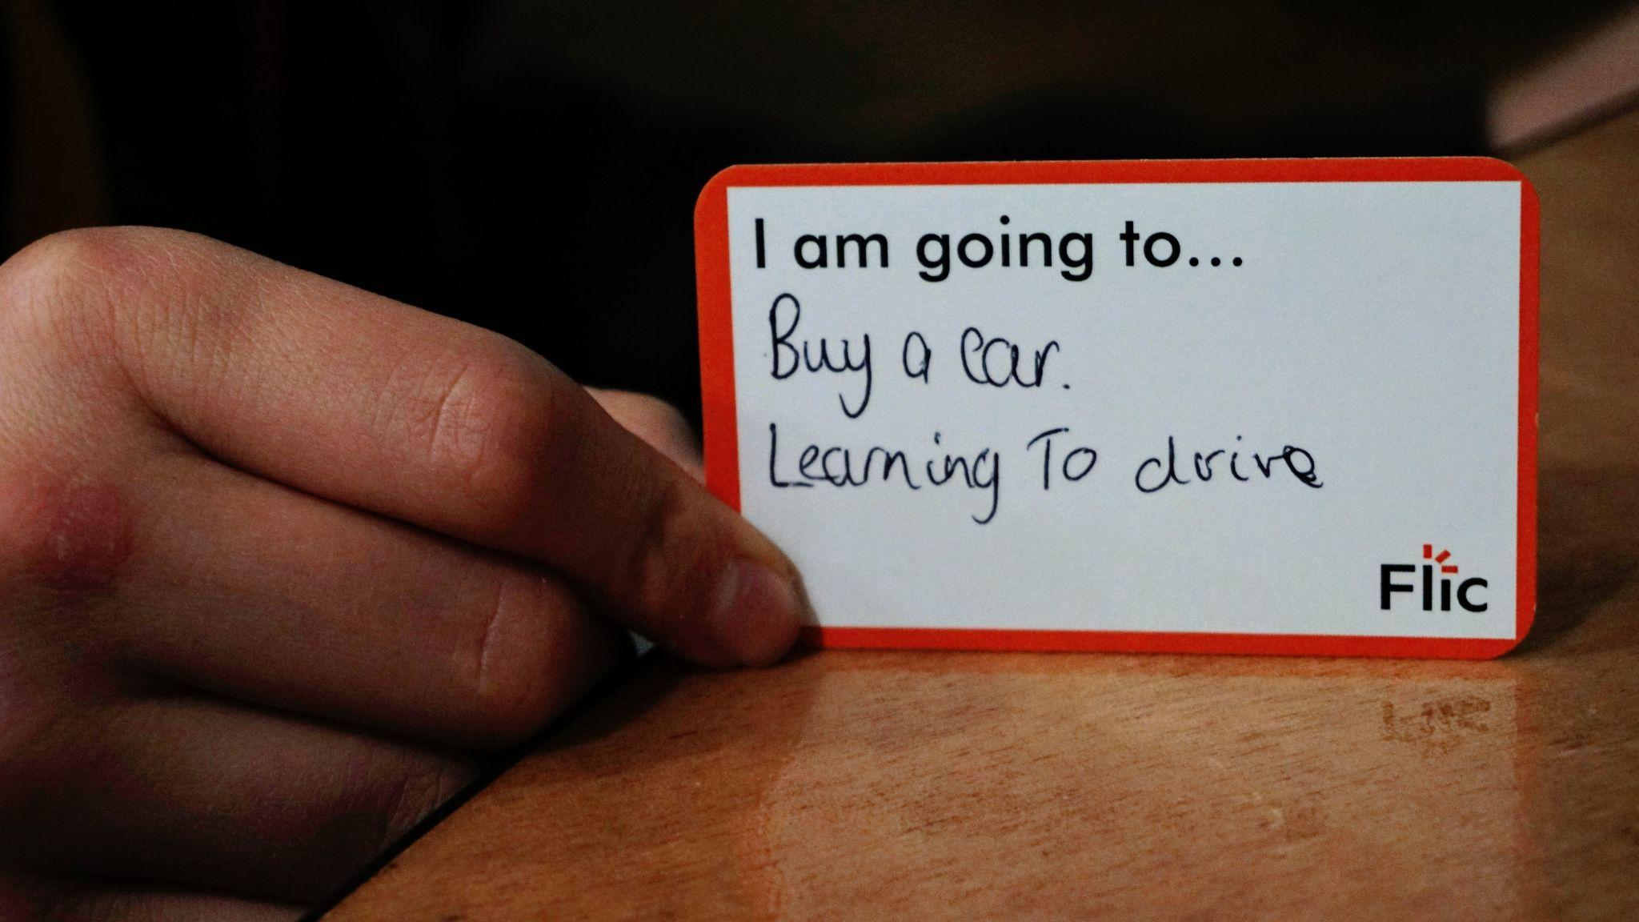
Planning your future

Slide 32
By the end of the session, I will be able to:
Describe the difference between financial needs and wants and the external influences that could impact them.
Determine smart choices about managing my money that align with needs, wants and future goals.
Identify different budgeting systems and how to apply them in different contexts.
Examine how income from jobs is taxed and calculate how much is left to budget.
Recognise inflation and understand how it is measured.
Explain how the value of money can change over time and how that impacts budgeting.

Slide 33
Learning Review
What is meant by the term ‘budget’?
What might be included in a person’s budget?
Why is it important to have a budget?

Slide 34
Any questions?
?

Slide 35
Chapter 3:
Understanding payslips

Slide 36
By the end of the session, I will be able to:
Describe the difference between financial needs and wants and the external influences that could impact them.
Determine smart choices about managing my money that align with needs, wants and future goals.
Identify different budgeting systems and how to apply them in different contexts.
Examine how income from jobs is taxed and calculate how much is left to budget.
Recognise inflation and understand how it is measured.
Explain how the value of money can change over time and how that impacts budgeting.

Slide 37
Having a respectful learning environment
We will listen to each other respectfully
We will avoid making judgements or assumptions about others
We will comment on what has been said, not the person who has said it
We won’t put anyone on the spot and we have the right to pass
We will not share personal stories or ask personal questions

Slide 38
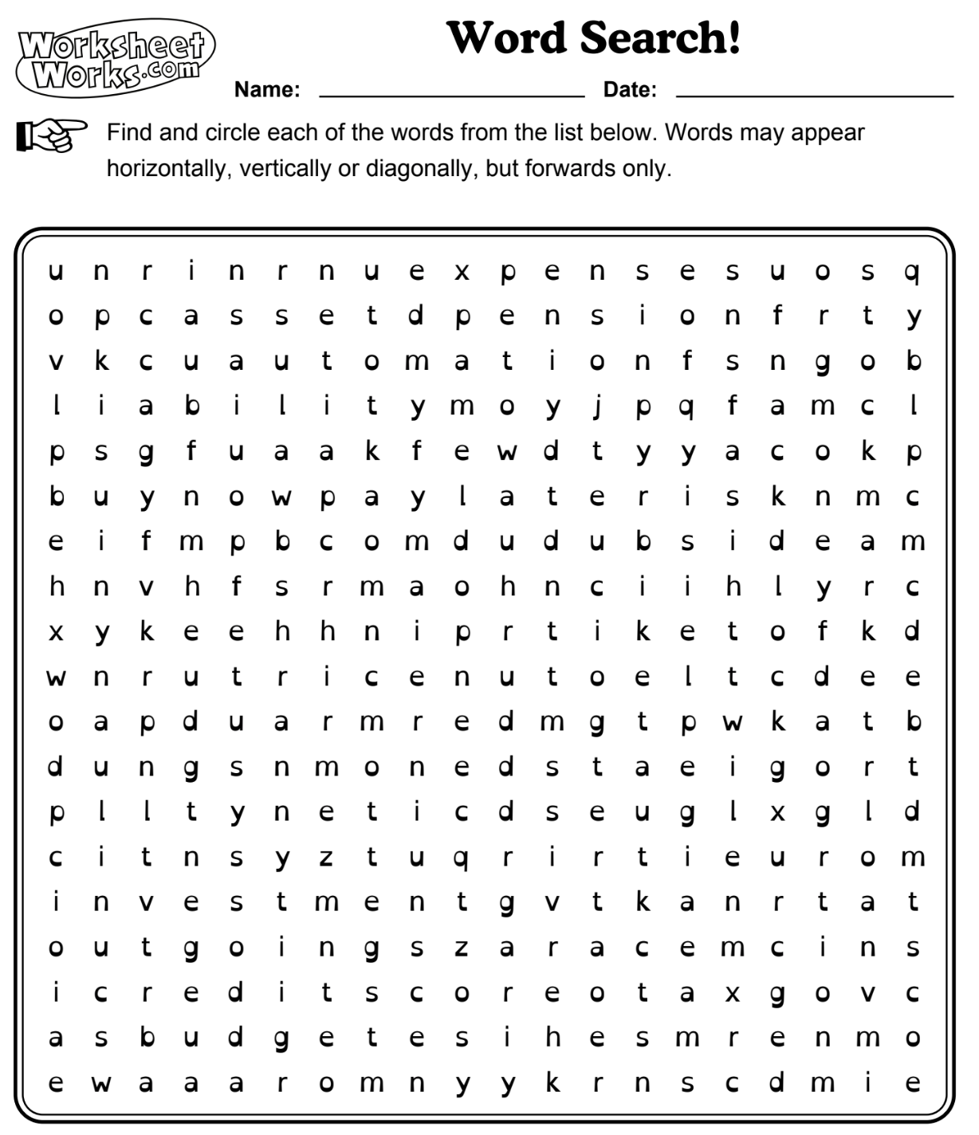
Learning Recap
Words
stock market | buy now pay later | expenses | automation | credit score | pension | credit card | investment | mortgage | outgoings | debit card | needs | budget | mindset | gross money | liability | income | wants | VAT | loan | ISA | net | tax | debt | risk | asset
Stretch:
Highlight the words that we have used in in our learning so far.
Write a sentence using two of the words.
Extension: Choose a word you have a question about

Slide 39
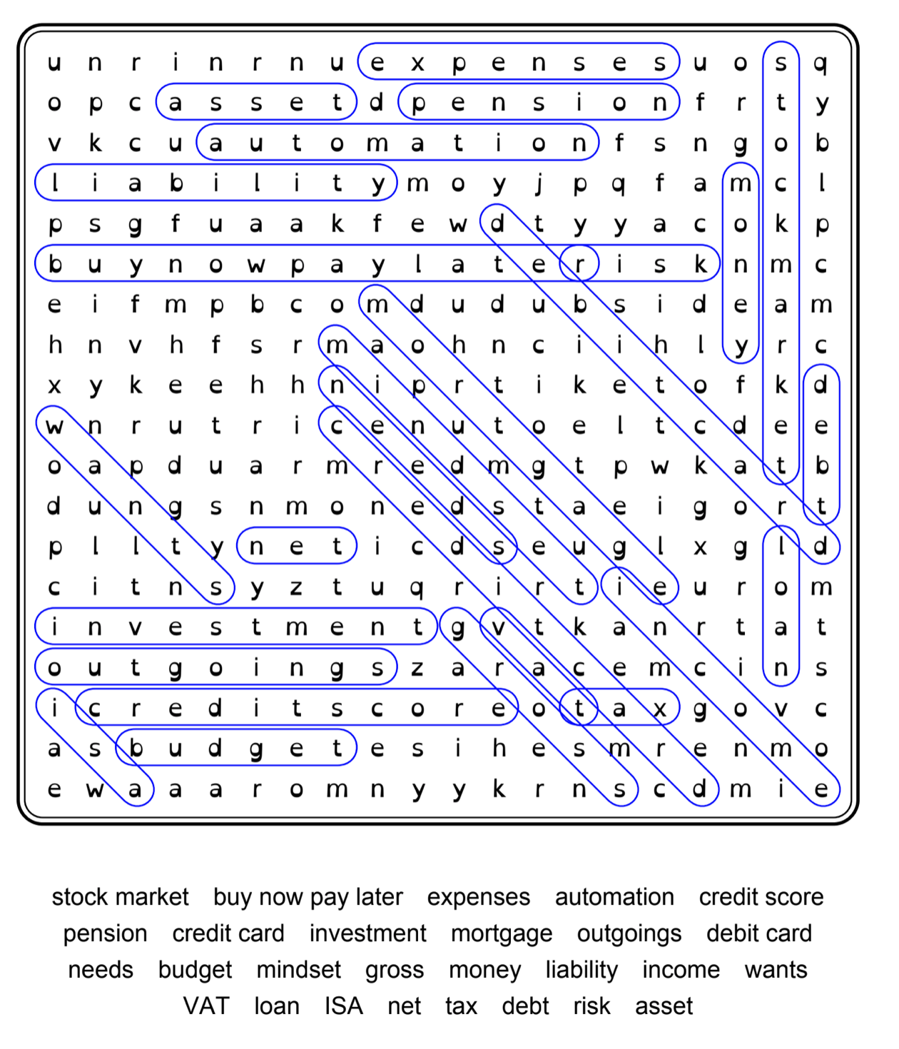
Word Search Answer Key
Words
stock market | buy now pay later | expenses | automation | credit score | pension | credit card | investment | mortgage | outgoings | debit card | needs | budget | mindset | gross money | liability | income | wants | VAT | loan | ISA | net | tax | debt | risk | asset
Stretch:
Write a sentence using two of the words.
Extension: Choose a word you have a question about

Slide 40
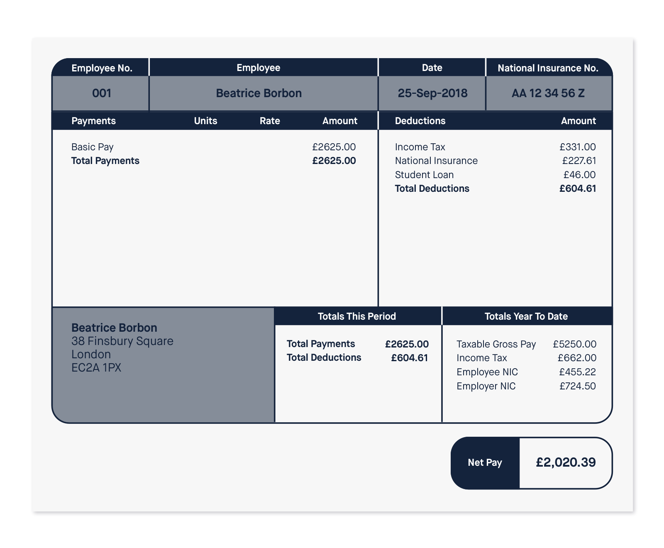
Understanding a payslip
What is this payslip
showing you?
Stretch: Can you write an equation to show how net pay is calculated?
Challenge: How do you think the amount for each deduction is decided?
Notes:
You will also have to pay a pension - more on that in wider FLIC modules.

Slide 41
Understanding a payslip
Today we’re going to learn about TAX.
Some people also pay a PENSION.
This is a deduction from your pay.
It is not shown on this payslip example.
It goes towards a person’s pension after they stop working.
Notes:
You will also have to pay a pension - more on that in wider FLIC modules.

Slide 42
Tax and other deductions
Income tax
Paid on earnings
Used for general public spending
The more a person earns, the more they pay
Why is it important to have this tax?

Slide 43
Calculating your monthly pay
Income tax
Key terms
Income tax = tax based on a person's earnings
Personal allowance = £12,570 (the amount a person can earn in a year before they pay any tax. This is non-taxable earnings)
Tax rate = 20% (for those earning £12,571 to £50,270)
Total income tax for the year =
(Income - Personal Allowance) x 0.20 (this represents 20% tax rate)
When a person goes up a band i.e. gets paid over a certain amount, they only pay the higher level of tax on any further money earned until they reach the next band.

Slide 44
Tax and other deductions
Income tax
Paid on earnings
Used for general public spending
The more a person earns, the more they pay
National Insurance
Paid on earnings
Used for state benefits
The more a person earns, the more they pay (to a point)

Slide 45
Calculating your monthly pay
National Insurance
Key terms
National Insurance = tax paid on money earned by workers and employers. It goes towards state benefits such as sick pay or maternity allowance.
Non-taxable amount (personal allowance) = £12,570*
Contribution rate = 13.25%
(for people earning £12,571 to £50,270, and 2% on anything more)
*correct until 5th April 2023
Total National Insurance for the year = (Income - Non Taxable Amount) x Contribution Rate
Total National Insurance for the year = (Income - £12,570) x 0.1325
This looks like a complicated number, but it is just 13.25% as a decimal

Slide 46
Tax and other deductions
Income tax
Paid on earnings
Used for general public spending
The more a person earns, the more they pay
National Insurance
Paid on earnings
Used for state benefits
The more a person earns, the more they pay (to a point)
Net pay
What’s left after deductions have been removed

Slide 47
Calculating your monthly pay
After tax has been deducted, how much money will a person make?
Monthly take home pay (NET pay)
Monthly NET pay = (Income – income tax – National Insurance) ÷ 12 (months in a year)
We are going to be calculating the tax amounts for different jobs.
Let’s practice one together for a salary of 20,000

Slide 48
Calculating your monthly pay
Income tax
Key terms
Income tax = tax based on a person's earnings
Personal allowance = £12,570 (the amount a person can earn in a year before they pay any tax. This is non-taxable earnings)
Tax rate = 20% (for those earning £12,571 to £50,270)
Total income tax for the year =
(Income - Personal Allowance) x 0.20 (this represents 20% tax rate)
When a person goes up a band i.e. gets paid over a certain amount, they only pay the higher level of tax on any further money earned until they reach the next band.

Slide 49
Calculating your monthly pay
National Insurance
Key terms
National Insurance = tax paid on money earned by workers and employers. It goes towards state benefits such as sick pay or maternity allowance.
Non-taxable amount (personal allowance) = £12,570*
Contribution rate = 13.25%
(for people earning £12,571 to £50,270, and 2% on anything more)
*correct until 5th April 2023
Total National Insurance for the year = (Income - Non Taxable Amount) x Contribution Rate
Total National Insurance for the year = (Income - £12,570) x 0.1325
This looks like a complicated number, but it is just 13.25% as a decimal

Slide 50
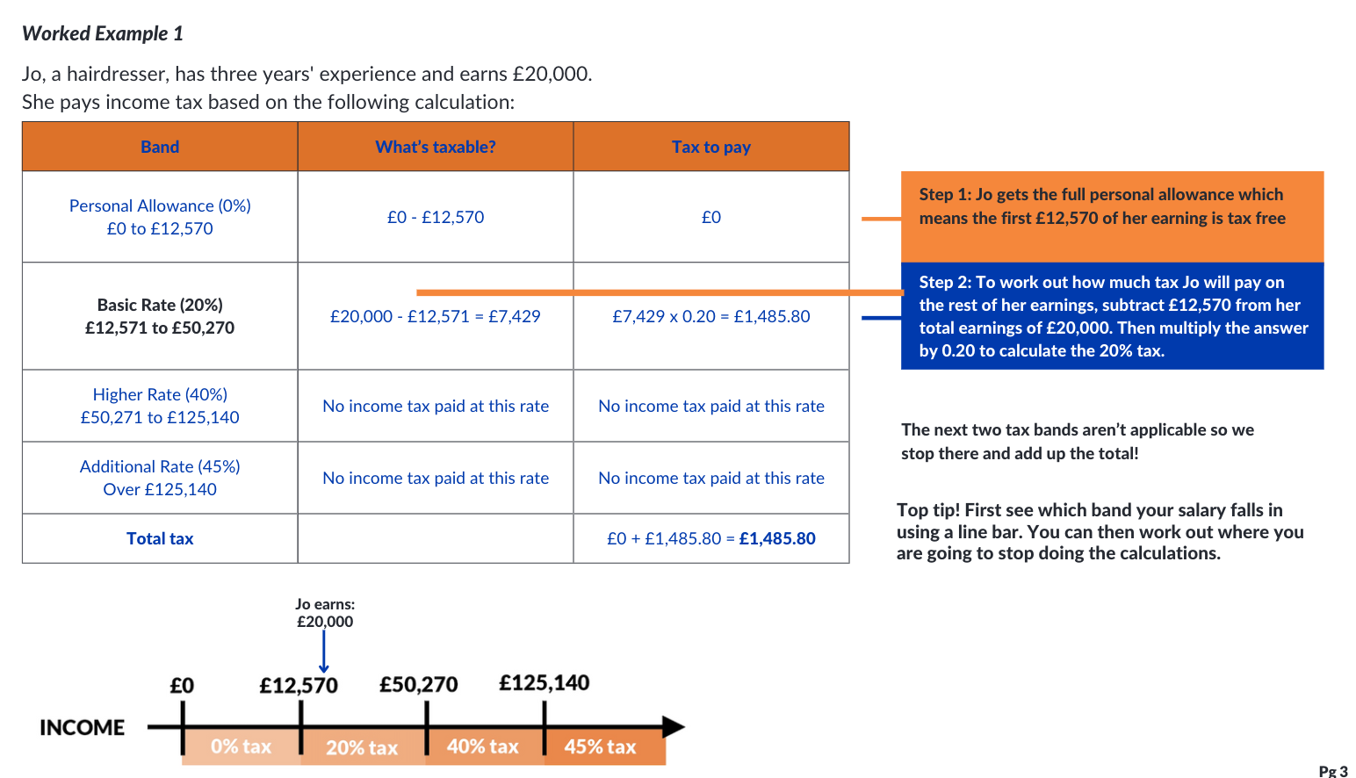
Calculating your monthly pay

Slide 51
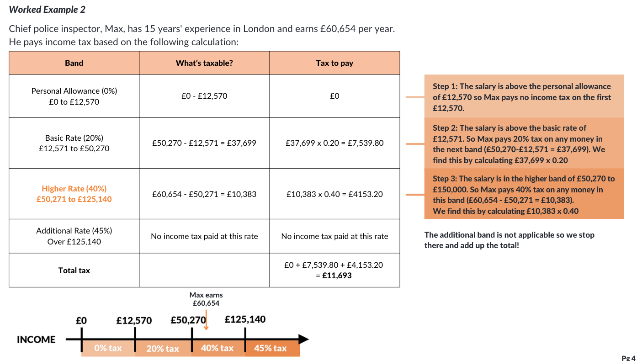
Stretch: Calculating your monthly pay

Slide 52
Calculating your monthly pay
After tax has been deducted, how much money will a person make?
Task!
Use your budget sheet to calculate the monthly net pay from an annual salary figure
Monthly take home pay (NET pay)
Monthly NET pay = (Income – income tax – National Insurance) ÷ 12

Slide 53
Calculating your monthly pay
THINK-PAIR-SHARE
To what extent is there a difference between the advertised salary and the take home salary?
What advice would you give to someone who is motivated by salary and looking for a new job?

Slide 54
Learning Review
3
Share 3 things you have learnt today.
This could be a definition such “national insurance is…” or
“We have deductions from our salary because…”
2
Identify 2 skills that you practiced today.
How have you applied numeracy skills today?
How have you used communication and teamwork skills today?
1
Is there one question that you still have about getting paid?

Slide 55
By the end of the session, I will be able to:
Describe the difference between financial needs and wants and the external influences that could impact them.
Determine smart choices about managing my money that align with needs, wants and future goals.
Identify different budgeting systems and how to apply them in different contexts.
Examine how income from jobs is taxed and calculate how much is left to budget.
Recognise inflation and understand how it is measured.
Explain how the value of money can change over time and how that impacts budgeting.

Slide 56
Any questions?
?

Slide 57
Chapter 3:
Inflation, what does it mean for budgeting?

Slide 58
Having a respectful learning environment
We will listen to each other respectfully
We will avoid making judgements or assumptions about others
We will comment on what has been said, not the person who has said it
We won’t put anyone on the spot and we have the right to pass
We will not share personal stories or ask personal questions

Slide 59
Learning Recap
Mariam looks after two children and works as a receptionist.
The eldest child is 16 and has asked for new equipment and clothes for the start of college. The younger child is turning five in November and Mariam would love to treat them to a trip to the theme park for their favourite cartoon character. This is likely to cost almost £400.
Write two lists for what Mariam might consider as the family’s needs and wants?
Stretch: How can Mariam be sure that she can afford all of these expenses.

Slide 60
Recap: How might a person’s wants change over time?
Sometimes changes to needs and wants are not due to changes to personal circumstances.
Political and Economic changes can determine changes to our spending behaviours.

Slide 61
By the end of the session, I will be able to:
Describe the difference between financial needs and wants and the external influences that could impact them.
Determine smart choices about managing my money that align with needs, wants and future goals.
Identify different budgeting systems and how to apply them in different contexts.
Examine how income from jobs is taxed and calculate how much is left to budget.
Recognise inflation and understand how it is measured.
Explain how the value of money can change over time and how that impacts budgeting.

Slide 62
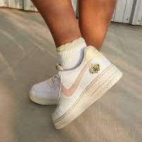
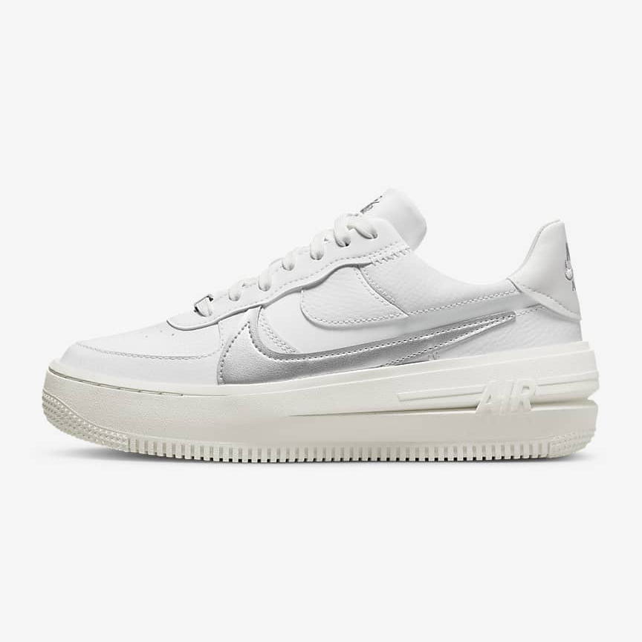
Rising costs
How much do you think the cost of Nikes has changed over time?
What other products have you seen change in price over time?
Can you remember the previous price and today’s price?
Explore your ideas with the person next to you on post-it notes.
But why?!
2007 | Nike Air Force 1 £76.36
2022 | Nike Air Force 1 £109.95
Notes:
Assuming average footwear inflation 2007-2022
https://www.in2013dollars.com/Footwear/price-inflation/2007-to-2022?amount=20
Aim of inflation unit:
Understand how the value of money can change over time and how that impacts by budget
Lesson flow
- Begin with teasing out students understanding of inflation with real world examples
- Students taught defn of inflation and Bank of England's target rate. Video shown to highlight the relevance of inflation today.
Challenge question: does anybody know the current inflation rate? Discussion may ensue. [can break this down in lesson notes for teachers]
- Students learn about how inflation is measured with the basket of goods & services. Activity to demonstrate how the basket and inflation measures adapt over time.
- Deflation is explored
- Hyperinflation is explored using Zimbabwe as a case study
- Key concepts brought together so students understand how inflation affects their own budgets and finances
- True / False quiz to assess student understanding and explore further / dive into concepts that are unclear.
Source: https://www.in2013dollars.com/Footwear/price-inflation
https://www.sneakerfiles.com/nike-2007-catalog-preview/
Key causes of inflation to look out for:
Supply
Increase in price of commodities e.g. oil and raw materials
Supply shortages from severe weather events such as flooding
Demand
Demand led inflation results from an increase in total demand for certain goods and services. So, for example, Apple can charge increasingly higher prices for their phones because they’re increasingly popular.
Activity idea - 'Weekly supermarket shop':
Tell students they each have £10 to spend on a supermarket shop.
Give them prices of various (approx 20) food/ drink items from 2012.
Ask them to write down their shop.
Give students updated prices for the same items in 2022.
Ask them the following:
(1) Who found out that the price of their basket went down?
(2) Who found out that the price of their basket went up?
(3) Which products increased a lot in price?
(4) Which products decreased a lot in price?
(5) Did anything about your items change except for the price?

Slide 63
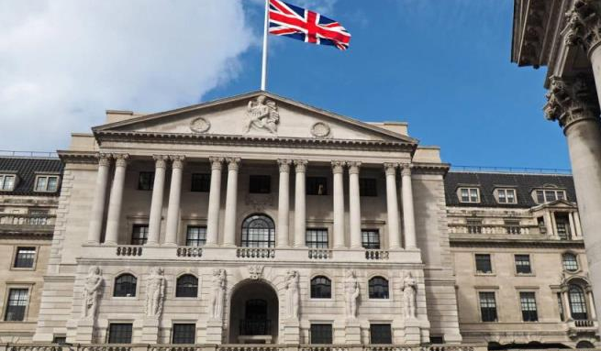
The Bank of England and the target rate of inflation
Welcome to the Bank of England. The Bank of England is the UK’s central bank and one of its roles is to keep prices stable. It does this by having an inflation target rate of about 2%.
Andrew Bailey
Governor of the Bank of England

Slide 64
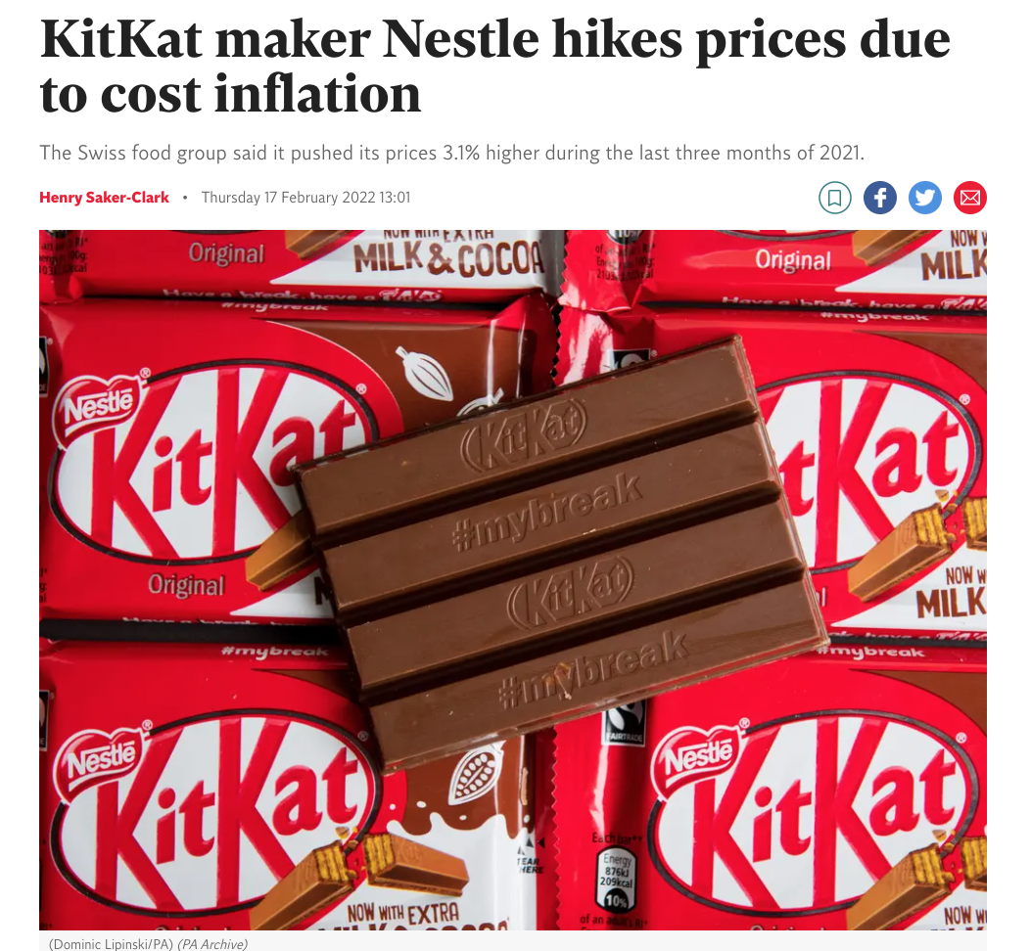
What do we mean by inflation?
Inflation is the word we use to describe the rise in the price of something.
How quickly prices go up is called the rate of inflation.
An annual inflation rate of 2% means that a product that was priced at £1.00 last year will now be priced at £1.02.
AKA: When inflation rises, you will be able to buy less of some things with the same amount of money than you did before, so the cost of living increases.

Slide 65
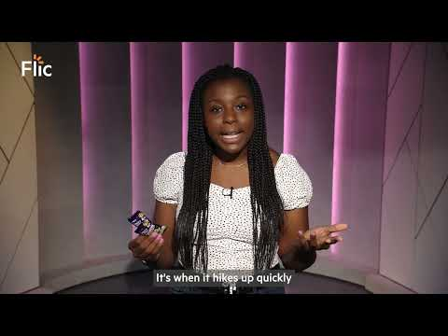
What does inflation mean as we spend?
Click here to watch a video about the rising cost of Freddos
Video made in collaboration with Olamide Majekodunmi

Slide 66
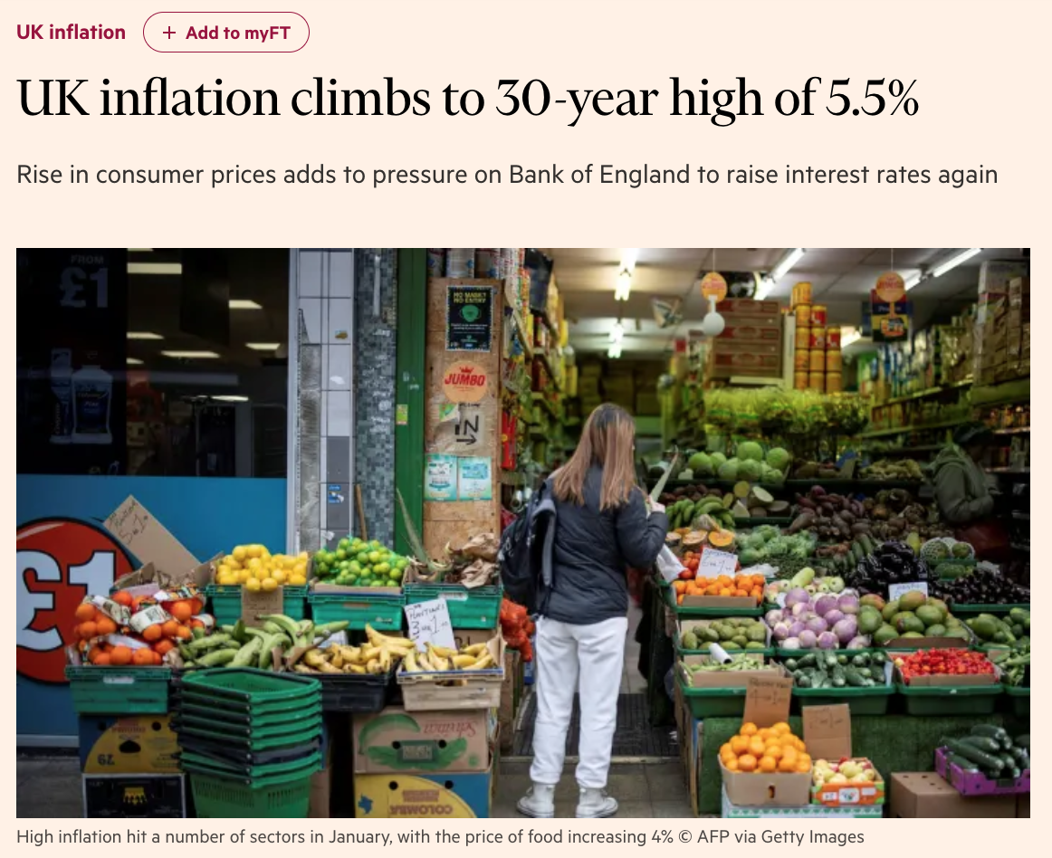
What is the inflation rate today?
Hotter or colder
rate is…
?
?

Slide 67
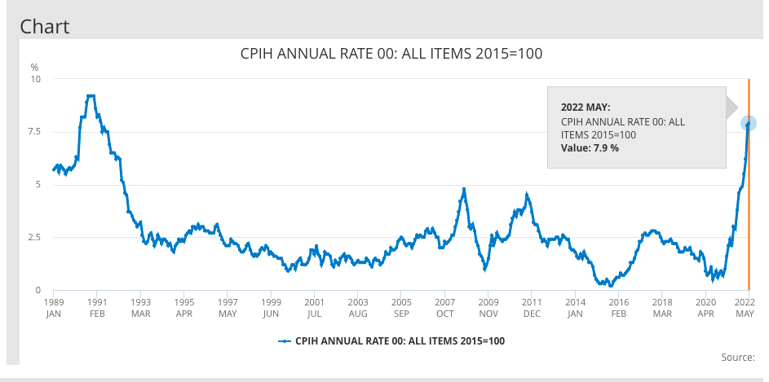
How has the UK’s inflation rate changed over time?
UK inflation over the past 10 years
When was inflation at its highest?
When was inflation at its lowest?
What has happened to inflation between 2020 and 2022?
Between what years was inflation ‘steady’ ?
Notes:
Source ONS: https://www.ons.gov.uk/economy/inflationandpriceindices/timeseries/l55o/mm23
- Needs to be regularly updated.
[need to think about this carefully as the 'rate' aspect may be confusing. Instead could be teacher led, with questions for students]
Activity addresses
* literacy skills - crafting robust definitions
* numeracy skills - analysing the graph/ understanding rates decreasing

Slide 68
Looking back | How has inflation changed over time?
Bank of England inflation calculator

Slide 69
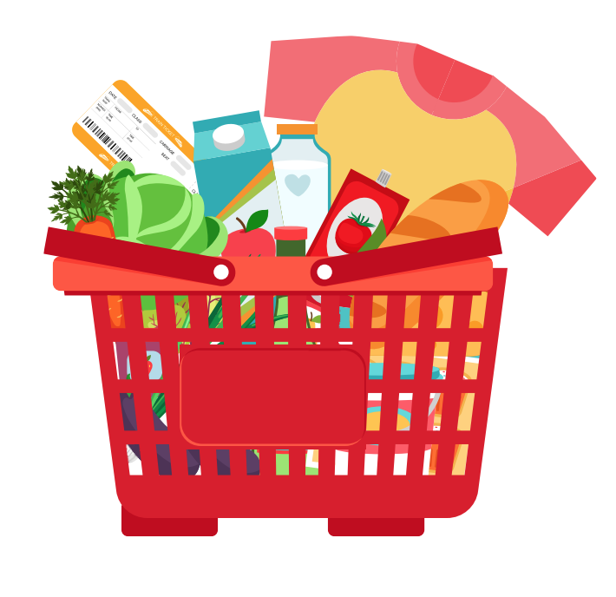
Measuring inflation | Basket of goods
Inflation is measured by tracking how the price of a basket of everyday items changes over time.
Consumer inflation is measured by taking a sample ‘shopping basket’ of around 700 goods and services each month in the UK, and monitoring how the total price of the basket changes.
Goods include things like food, clothes and petrol. Services include things like transport, restaurants and cinema trips.
This is known as the ‘Consumer Prices Index’ (CPI)
Notes:
.

Slide 70
Check in, check out
Part 1 | It’s 2015.
You’re going food shopping and have a £26.50 budget for your weekly food shop. Your task is to pick all of the ingredients and items you want to purchase to make meals for a week, sticking to your budget.

Slide 71
Check in, check out
Part 2 | You’ve jumped forward a few years and it’s now 2022! Using the 2022 Grocery Items List, calculate the total cost of the same shop at the same supermarket using the updated price list.
When your shopping lists are completed, answer the following questions:
Is the total cost lower or higher than the original £26.50 total?
Which items have increased or decreased in price and why do you think these changes have taken place?
If the cost of products that I need like food has gone up, what does this mean for the money I have left for my wants or that I want to save or invest?

Slide 72
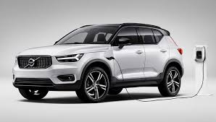
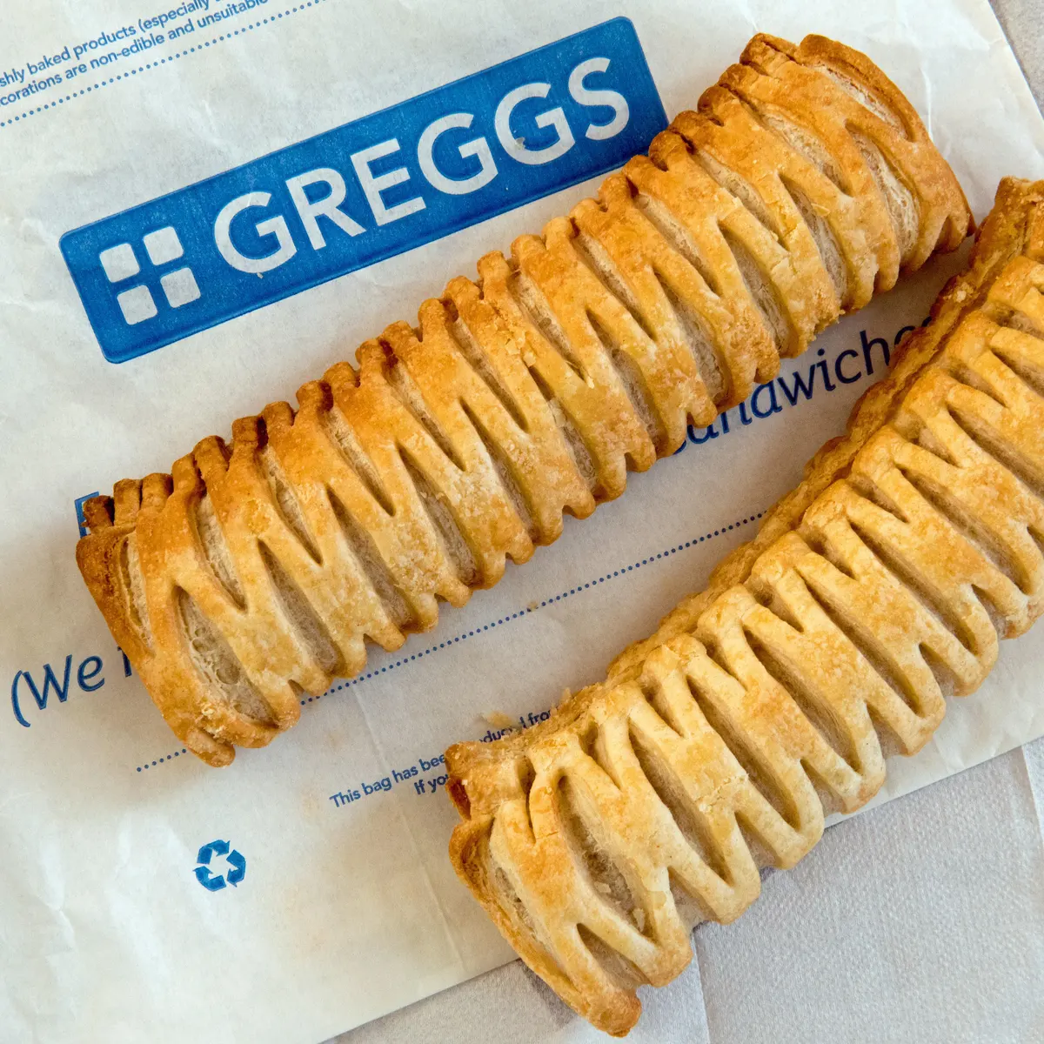
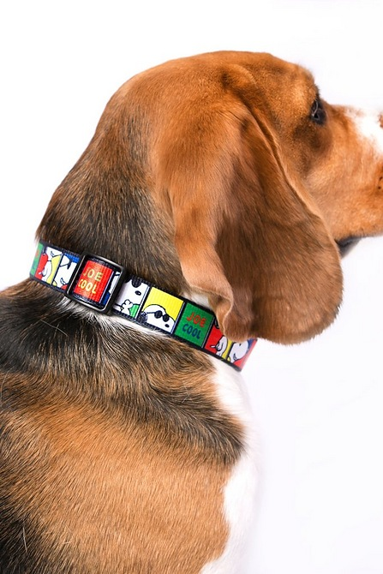
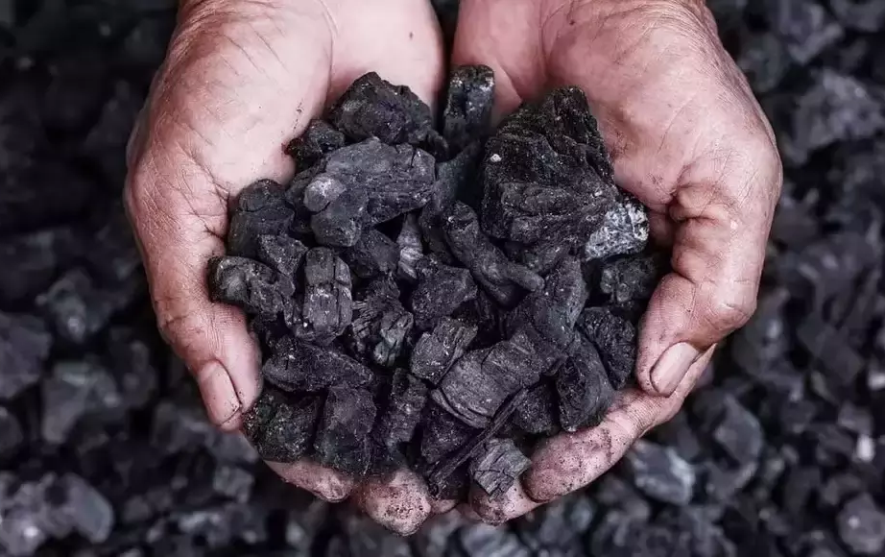
2022 Basket of goods Added, remained or removed?
Doughnuts
New cars
Veggie sausages
Anti-bacterial wipes
REMOVED
REMAINED
ADDED
ADDED
Pizza
Pet collar
Men’s suits
Coal
REMAINED
ADDED
REMOVED
REMOVED
Optional resource
Source: ONS, 2022

Slide 73
Budgeting and Wellbeing
For many families rising inflation has been stressful to manage.
Remember that inflation changes over time and this period will not last forever.
As you have learnt, there are things that people can do to adjust their budgets including reconsidering what things are needs and wants.
There are many sources of advisory services and help for families who are experiencing financial difficulties.

Slide 74
Services available for people who have concerns about their personal finance
Citizen’s Advice – ‘Debt and Money’ – this resource contains links to advice on a number of topics including financial difficulties, cost of living and communications with creditors
MoneyHelper – Help if you’re struggling with debt – this resource provides a guide for individuals who are having issues keeping up with their debts.
At school, you can speak with an adult you trust.
This could be your form tutor, head of year or the school’s safeguarding officer

Slide 75
Inflation | Multiple choice
Inflation is…
A | B | C
the increase in prices of goods and services over time | the decrease in prices of goods and services over time | when prices of goods and services remain the same over time

Slide 76
Inflation | Multiple choice
Inflation is…
A | B | C
the increase in prices of goods and services over time | the decrease in prices of goods and services over time | when prices of goods and services remain the same over time

Slide 77
Inflation | Multiple choice
2. When inflation goes up…
A | B | C
Spending increases as people have more money to spend | Spending decreases as the cost of living goes up so people have less money to spend | Nothing changes because people's spending is not affected

Slide 78
Inflation | Multiple choice
2. When inflation goes up…
A | B | C
Spending increases as people have more money to spend | Spending decreases as the cost of living goes up so people have less money to spend | Nothing changes because people's spending is not affected

Slide 79
Inflation | Multiple choice
3. The Bank of England wants to keep the target inflation rate at around
A | B | C
0% | 2% | 7%

Slide 80
Inflation | Multiple choice
3. The Bank of England wants to keep the target inflation rate at around
A | B | C
0% | 2% | 7%

Slide 81
Inflation | Multiple choice
4. Which of these items was removed from 2022’s basket of goods and services?
A | B | C
Pizza | Anti-bacterial wipes | Men’s suits

Slide 82
Inflation | Multiple choice
4. Which of these items was removed from 2022’s basket of goods and services?
A | B | C
Pizza | Anti-bacterial wipes | Men’s suits

Slide 83
Inflation | Multiple choice
5. When shrinkflation happens, a product's price in shops (retail price) stays the same, but what happens to its size?
A | B | C
Decreases | Increases | Stays the same

Slide 84
Inflation | Multiple choice
5. When shrinkflation happens, a product's price in shops (retail price) stays the same, but what happens to its size?
A | B | C
Decreases | Increases | Stays the same

Slide 85
Inflation | Multiple choice
6. Inflation is measured by taking a sample ‘shopping basket’ of around how many goods and services across the UK?
A | B | C
70 | 700 | 7000

Slide 86
Inflation | Multiple choice
6. Inflation is measured by taking a sample ‘shopping basket’ of around how many goods and services across the UK?
A | B | C
70 | 700 | 7000

Slide 87
Inflation | Multiple choice
7. The ……………………….. considers the measure of is measured by taking a sample ‘shopping based’ of around how many goods and services across the UK?
A | B | C
Bank of England | Producer price index | Consumer price index

Slide 88
Inflation | Multiple choice
7. The ……………………….. considers the measure of is measured by taking a sample ‘shopping based’ of around how many goods and services across the UK?
A | B | C
Bank of England | Producer price index | Consumer price index

Slide 89
Inflation | Multiple choice
8. When inflation goes up over the long run, what happens to the value of salary money earned from a job (assuming it stays the same)?
A | B | C
It goes down | It goes up | It is not impacted

Slide 90
Inflation | Multiple choice
8. When inflation goes up over the long run, what happens to the value of salary money earned from a job (assuming it stays the same)?
A | B | C
It goes down | It goes up | It is not impacted

Slide 91
By the end of the session, I will be able to:
Describe the difference between financial needs and wants and the external influences that could impact them.
Determine smart choices about managing my money that align with needs, wants and future goals.
Identify different budgeting systems and how to apply them in different contexts.
Examine how income from jobs is taxed and calculate how much is left to budget.
Recognise inflation and understand how it is measured.
Explain how the value of money can change over time and how that impacts budgeting.

Slide 92
Money mindsets
Reflection: Have any of your views changed?
Agree Disagree
1. Money is easy to come by
2. Money is there to be spent
3. People should always be aware of how much money is in
their bank account
4. People should distinguish between essential and non-essential spending
5. People should always save some of the money they earn

Slide 93
Over to you…
What are the three most
important messages that you think will help you to look after your money in the future?
Consider your payslip, budgeting and inflation knowledge

Slide 94
Any questions?
?

Slide 95
Links to learn more!
Articles to extend learning
‘What is the UK's inflation rate and why is the cost of living going up? (BBC, Feb 2022)
How to stop spending (MoneySavingExpert, March 2022)
How does inflation affect me? (Teen Learner, Sept 2021)
Will inflation in the UK keep rising? (Bank of England, May 2022)
5 steps to automating your finances (Forbes, Jan 2018)
Please visit the FLIC learning hub - https://ftflic.com/learning-hub/ for further resources

Slide 96
Create a storyboard, video or post giving your friend your top tips on budgeting

